Slide 1
Samsung
Innovation
Campus
Artificial Intelligence Course

Slide 2
Chapter 3.
Exploratory Data Analysis:
NumPy Arrays for Optimized Numerical Computation and Pandas
AI Course

Slide 3
Chapter Description
Chapter objectives
Understand the precise use of NumPy and be able to process data efficiently.
Learn the basics of NumPy arrays, indexing, and slicing and the various ways of their application.
Learn to create and handle series and data frame objects.
Learn the appropriate methods of optimal model execution for data preprocessing using the Pandas library to explore and convert data.
Be able to find the appropriate analysis method by implementing a data visualization suitable for the data scale.
Chapter contents
Unit 1. NumPy Array Data Structure for Optimal Computational Performance
Unit 2. Optimal Data Exploration Through Pandas
Unit 3. Pandas Data Preprocessing for Optimal Model Execution
Unit 4. Data Visualization for Various Data Scales

Slide 4
Unit 1.
NumPy Array Data Structure for Optimal Computational Performance
1.1. NumPy Arrays
1.2. NumPy Array Basics
1.3. NumPy Array Operations
1.4. NumPy Indexing and Slicing
1.5. Array Transposition and Axis Swap

Slide 5
1.1. NumPy Arrays
UNIT 01
Data Structure
The most important concepts in programming are data types, data structures, and algorithms. Knowing the clear differences between these three concepts is essential for easily dealing with various programming languages and solving many errors.

Slide 6
1.1. NumPy Arrays
UNIT 01
Data Type
First, a data type, in computer science and programming languages, is a classification that identifies a type of data such as floats, integers, Booleans, characters, and strings while also determining the size of the data. It should be used by applicable data types. The data types differ by programming language, but most of the data type concepts from the C language are inherited and used and have affected other languages.
Memory is expensive, but when C was introduced, it was expensive and difficult to store a lot of data. As a result, it was designed to be optimized for storing as little space as necessary, which eventually resulted in a data size problem.
For example, in C, integer data types are divided into char(compatible with integers), short, int, and long. Each byte size differs from the other data types.

Slide 7
1.1. NumPy Arrays
UNIT 01
Data Type
Second, data structure in computer science refers to the organization, management, and storage of data that enables efficient access and modification. It relies heavily on the data structure to find data in the fastest way. In other words, finding data is a matter of algorithms (which will be explained later), so a good data structure can be said to be a necessary and sufficient condition for a good algorithm.
To be more specific, the data structure refers to a group of data values, a relationship between data, and a function or command applicable to the data. Carefully selected data structures make it possible to use more efficient algorithms.
An effectively designed data structure allows operations to be performed with minimal resources, such as execution time or memory capacity.
There are several types of data structures, each of which is tailored for each operation and purpose.
When designing various programs, it should be the priority to consider and select the most appropriate data structure. This is because when manufacturing a large-scale system, the implementation difficulty and the final product’s performance depend heavily on the data structure.
Once the data structure is selected, it becomes relatively clear which algorithm needs to be applied. There are times when this order is reversed, and they are when the target operation necessarily requires a particular algorithm, and the given algorithm produces the best performance with the particular data structure. In any case, it is essential to select an appropriate data structure.

Slide 8
1.1. NumPy Arrays
UNIT 01
Algorithm
Third, an algorithm is a formulation of a set of procedures or methods to solve any solvable problem and refers to a step-by-step procedure for executing a calculation.
Algorithms are the most important in the fields of machine learning and deep learning, areas we will cover in the future because it requires work with a lot of data.
In the end, as the performance of the algorithm is directly related to the performance of the data structure, it can be said that it is most important to know precisely where to use a certain data structure.

Slide 9
1.1. NumPy Arrays
UNIT 01
Data Structures in Python
First, the following are the types of data structures used in computer science:
Integer
Primitive
Float
Char
String
Linear
Sequential List
Singly Liked List
Linked List
Doubly Linked List
Data Structure
Stack
Circular Linked List
Queue
Deque
General Tree
Non-Linear
Tree
Binary Tree
Graph
General Tree
Binary Tree
File
Sequential File
Indexed File
Direct File

Slide 10
1.1. NumPy Arrays
UNIT 01
Types of Data Structures (1/2)
However, we will only concern ourselves with the data structure of the Python language here. In general, it can be largely divided into a primitive data structure, a structure for basic types, and a non-primitive data structure, a structure for effectively storing multiple data with basic data types.
The most commonly and conveniently used non-primitive data structure in Python is the list. This is because the size of the data is not fixed while storing several different data types (integer, character, etc.)
However, the advantage has become inappropriate in the fields of machine learning and deep learning, where more data must be quickly and exclusively processed in numbers.
This is because computers must take decimal numbers understood by humans and convert them into binary forms to perform fast operations and use the same numerical data to directly access and calculate each element without repetition.
In the end, computers can only perform operations when letters/characters are converted into numbers.

Slide 11
1.1. NumPy Arrays
UNIT 01
Types of Data Structures (2/2)
Compensating for such shortcomings is the array data structure. Python, however, does not directly support the array; rather, the array data structure can be used through the NumPy library.
Data Structure
Primitive
Non-Primitive
Integer
Float
String
Boolean
Dictionary
List
Array
Tuple
Set
File
Linear
Non-linear
Stacks
Queues
Graphs
Trees

Slide 12
1.1. NumPy Arrays
UNIT 01
Method of Memory Storage Per Data Structure
To understand why array data structures enable such rapid operations, we first need to know how they are stored in memory for each data structure.
Normally, for most languages, an array is referred to as a group of data created by listing data of the same data type and storing them contiguously in memory.
Each value in it is called an element of an array. These elements use the number called an index, which always starts at zero, to simply distinguish an array’s elements. Most data types can be configured in an arrangement and consist of a one-dimensional arrangement, a two-dimensional arrangement, and a three-dimensional arrangement, depending on the configuration type.
Previously, it was explained that the data structure was a concept that focused primarily on effectively storing data. Finding out how the data are stored in the array and the list is the precise way to understand the array’s pros and cons and know the reason for its use.

Slide 13
1.1. NumPy Arrays
UNIT 01
Storage and Access of Data in an Array (1/2)
The following is the process of accessing existing data when storing it in an array and adding and deleting new data. You should compare it with the list that follows.
Suppose three pieces of data with strings representing the following colors are stored in an array.
Each element may be accessed through each index. An index is a number representing an order. Data is sequentially stored in a contiguous location of memory, as shown in the figure below.
Blue
Yellow
Red
Memory
Blue
Yellow
Red

Slide 14
1.1. NumPy Arrays
UNIT 01
Storage and Access of Data in an Array (2/2)
Since the data is stored in a contiguous location, the address of the memory can be accessed with an index, and the data can be randomly selected to access the desired location of the data. Here is a picture where the data approaches the red in the third room (we will express the concept of a variable that mainly stores one value as a room) and approaches the blue room. Random access is possible through the index.
a[0]
a[1]
a[2]
Blue
Yellow
Red
Random Access
a[0]
a[1]
a[2]
Blue
Yellow
Red
a[0]
a[1]
a[2]
Blue
Yellow
Red
a[0]
a[1]
a[2]
Blue
Yellow
Red

Slide 15
1.1. NumPy Arrays
UNIT 01
Adding and Deleting Data From the Array (1/4)
Another feature of the array is that adding or deleting data to a specific location requires more computation and space in comparison to the list. The calculation here is that it takes more time for the CPU to calculate, and more space in memory is also needed.
Consider adding the value “Green” to the second position.
First, we need to secure additional space at the end of the arrangement.
a[0]
a[1]
a[2]
Blue
Yellow
Red
Green
a[0]
a[1]
a[2]
a[3]
Blue
Yellow
Red
Green

Slide 16
1.1. NumPy Arrays
UNIT 01
Adding and Deleting Data From the Array (2/4)
To add data to the second space, the data behind the second space must move to the right one by one.
The “Green” data is then added to the empty space.
a[0]
a[1]
a[2]
a[3]
Blue
Yellow
Red
a[0]
a[1]
a[2]
a[3]
Blue
Yellow
Red
Green
a[0]
a[1]
a[2]
a[3]
Blue
Green
Yellow
Red

Slide 17
1.1. NumPy Arrays
UNIT 01
Adding and Deleting Data From the Array (3/4)
Conversely, when deleting the second element–the “Green” value, remove the element first, then move the value to the left one by one so there is no empty space.
a[0]
a[1]
a[2]
a[3]
Blue
Green
Yellow
Red
a[0]
a[1]
a[2]
a[3]
Blue
Yellow
Red
Green
a[0]
a[1]
a[2]
a[3]
Blue
Yellow
Red
a[0]
a[1]
a[2]
a[3]
Blue
Yellow
Red

Slide 18
1.1. NumPy Arrays
UNIT 01
Adding and Deleting Data From the Array (4/4)
It is completed by deleting the last remaining space.
a[0]
a[1]
a[2]
Blue
Yellow
Red
Green

Slide 19
1.1. NumPy Arrays
UNIT 01
Saving and Accessing Data From the List (1/4)
The following is a method of storing data in the list data structure.
To understand lists, you must first understand the concept of the pointer. In simple terms, the pointer is an address value that points to a certain value.
As shown in the figure above, the blue room (the concept of a variable representing one value will be expressed as a room) points to the yellow room. Let’s say the blue room has the address of the yellow room’s memory location. Then each room can point to the next room.
Blue
Yellow
Red

Slide 20
1.1. NumPy Arrays
UNIT 01
Saving and Accessing Data From the List (2/4)
Lists are not stored sequentially but in separate locations.
Memory
Yellow
Pointer
Blue
Pointer
Red
Pointer

Slide 21
1.1. NumPy Arrays
UNIT 01
Saving and Accessing Data From the List (3/4)
Since the pointer of the “Blue” value refers to the address of the “Yellow” value, and the pointer of the yellow value refers to the “Red” value, the order may be maintained.
Memory
Yellow
Pointer
Blue
Pointer
Red
Pointer

Slide 22
1.1. NumPy Arrays
UNIT 01
Saving and Accessing Data From the List (4/4)
Since the data is stored in non-contiguous addresses, sequential approaches are accessed through the pointer that precedes them.
Sequential Access
Blue
Yellow
Red
Blue
Yellow
Red
Blue
Yellow
Red
Blue
Yellow
Red
Blue
Yellow
Red

Slide 23
1.1. NumPy Arrays
UNIT 01
Adding and Deleting Data From the List
Now, let’s look at the case of adding the “Green” data.
Blue
Yellow
Red
Green
Blue
Yellow
Red
Blue
Yellow
Red
Green
Green
As shown in the picture above, using each pointer, the blue points to the green, and the green points to the yellow to add the green.

Slide 24
1.1. NumPy Arrays
UNIT 01
What is NumPy?
NumPy stands for Numerical Python, which is a basic package for Data Science.
It is a Python Library that provides multidimensional array objects, various derived objects (matrices, etc.), and an assortment of routines for fast operation on arrays.
It supports discrete Fourier transforms, basic linear algebra, basic statistical operations, random simulations, etc.
The ndarray object is the core of the NumPy package. It processes n-dimensional arrays of homogenous data types.

Slide 25
1.1. NumPy Arrays
UNIT 01
Distinguish the differences between NumPy arrays and standard Python sequences (Lists, Tuples, Dictionaries, Sets).
NumPy arrays have a fixed size when generated as opposed to Python Lists (which can grow dynamically).
A change in the size of the ndarray creates a new array and deletes the original.
The elements of the NumPy array are all homogenous data types; thus, they maintain the same size in memory.
Lists, however, allow for arrays of various sizes.
NumPy arrays easily calculate advanced mathematical and other types of operations on large numbers of data.
Normally, such operations are performed more efficiently and with less code than when performed with Python’s built-in sequences.
More and more scientific and mathematical Python-based packages are using NumPy arrays. These typically support Python sequence input, but they convert such input to NumPy arrays before processing and often output NumPy arrays.
In other words, it is insufficient to rely only on Python’s built-in sequences to efficiently use today’s scientific/mathematical Python-based software. One also needs to have a knowledge of NumPy array to increase efficiency.
Notes:
전 슬라이드에서 컴퓨터 과학에서의 배열과 리스트의 장, 단점을 먼저 상기시키며 파이썬에서의 배열과 리스트 개념을 학습하도록 가이드 한다.

Slide 26
1.1. NumPy Arrays
UNIT 01
Why Use NumPy Arrays? (1/3)
Previously, we learned that Python does not directly support arrays but allows for data structure arrangement through the NumPy library.
The arrangement concepts learned in standard programming languages are not too different in Python.
In programming, decreasing loops is the method to increase performance.
Loops in large-scale computations require a computation per repetition, causing poor performance.
NumPy arrays allow for a wide variety of data processing operations through concise array operations as opposed to loops.
The use of array computing to explicitly remove loops is called Vectorization. Mathematical operations for vectorized arrays are typically two to three, if not ten or even a hundred times faster than pure Python operations. Broadcasting, another method that we will learn later, is a very powerful vector operation.
Notes:
Teach the arrays/lists of Python while reminding about the advantages and disadvantages of array/list in computer programming that you already taught.

Slide 27
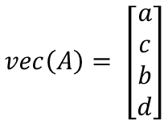
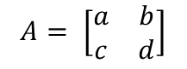
1.1. NumPy Arrays
UNIT 01
Why Use NumPy Arrays? (2/3)
Since the NumPy array operation uses an internal iteration implemented in C, it is faster than the Python iteration and performs a linear algebraic operation using a vectorized operation.
A vectorization operation is one of the linear transformations that transform a matrix into a vertical vector, as shown below.
Since it works throughout the vector, it can be used instead of for and while loops.
In scikit-learn, the NumPy arrangement is the basic data structure. In other words, the NumPy arrangement should be used as the standard input/output for machine learning.
$$vec\left(A\right)= \left[\begin{aligned}a \\ c \\ b \\ d\end{aligned}\right]$$
2x2 matrix
$$A= \left[\begin{matrix}a & b \\ c & d\end{matrix}\right]$$
through vectorization become

Slide 28
1.1. NumPy Arrays
UNIT 01
Why Use NumPy Arrays? (3/3)
In scikit-learn, the NumPy arrangement is the basic data structure. In other words, the NumPy arrangement should be used as the standard input/output for machine learning.
Scikit-Learn is a Python machine learning library.
Since scikit-learn receives data in the form of a NumPy array as input, all data to be used in the future must be converted into a NumPy array.

Slide 29
Unit 1.
NumPy Array Data Structure for Optimal Computational Performance
1.1. NumPy Arrays
1.2. NumPy Array Basics
1.3. NumPy Array Operations
1.4. NumPy Indexing and Slicing
1.5. Array Transposition and Axis Swap

Slide 30
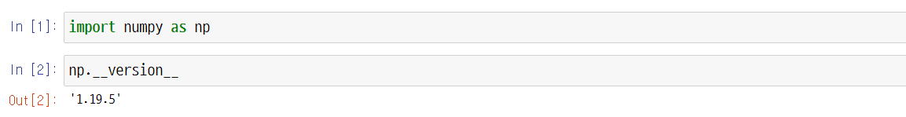
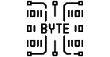
1.2. NumPy Array Basics
UNIT 01
How to Import NumPy
NumPy Library Import
For better readability of the code, abbreviate NumPy to np. This is a rule adopted by all those working with codes so that it can be easily understood.
In Python, objects generally have properties and methods. The property is another Python object stored inside the object, and the method refers to a function that allows access to the internal data of the object. It can be approached in the form of np.attrribute_name.
Line 1
As stands for alias, meaning it is abbreviated.
Line 2
To view the version of NumPy, use the built-in property ____version__.

Slide 31
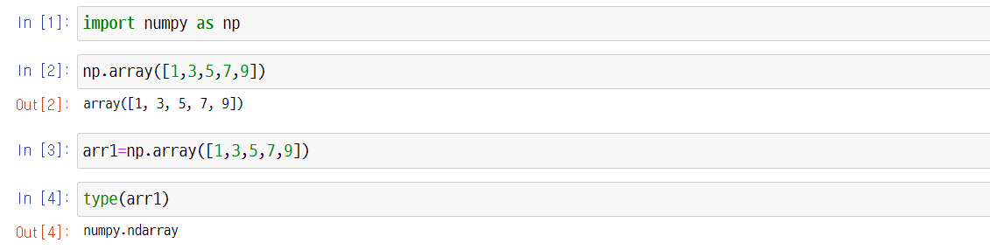
1.2. NumPy Array Basics
UNIT 01
NumPy Array Basics
NumPy ndarray
An n-dimensional array object is called a ndarry. It can be used to process and store large datasets.
Fast and flexible arrangements use a similar grammar used for operations between scalar elements. They use mathematical operations for the entire data block.
First, an arrangement may be made into a sequence (list, tuple, array, set).
Notes:
NumPy arrays can be created in many different ways.
Be careful to avoid simple assignments. You are not creating a new object.
Instead, you are creating a different name for the same object.

Slide 32
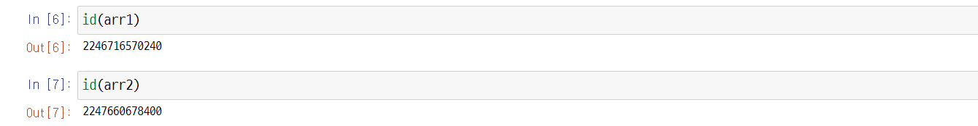
1.2. NumPy Array Basics
UNIT 01
Here is one more arrangement.
Check the address of each array using a function representing the address id.

Slide 33
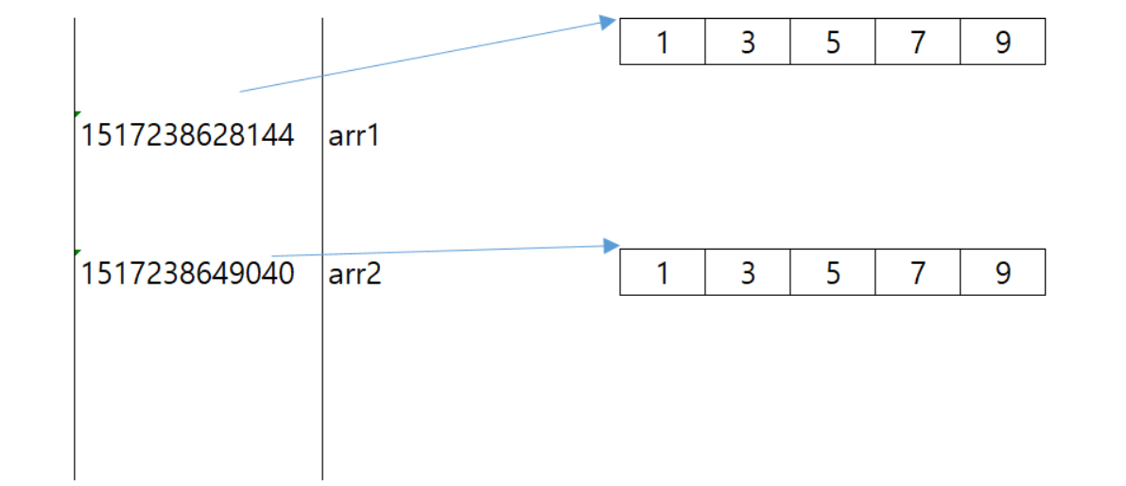
1.2. NumPy Array Basics
UNIT 01
The actual value inside is the same, but the address is confirmed to be different because it is its own object.
1
3
5
7
9
2246716570240
arr1
2247660678400
arr2
1
3
5
7
9
In Python, the = symbol is an assignment operator that assigns address values.
Notes:
Help students don’t be confused because they see different address on their computer monitor.
Each computer has its unique address. So students will see the different address in their computer screen.

Slide 34
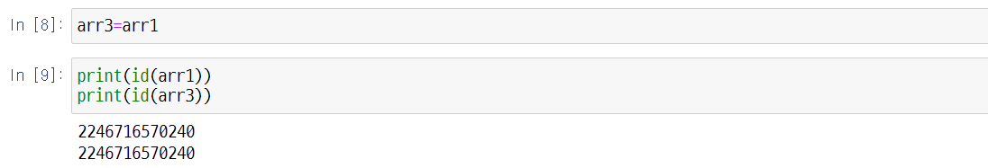
1.2. NumPy Array Basics
UNIT 01
Let’s assign the address arr1 to the variable arr3.
Line 9
After assigning the address values, we can see that the address values are the same.

Slide 35
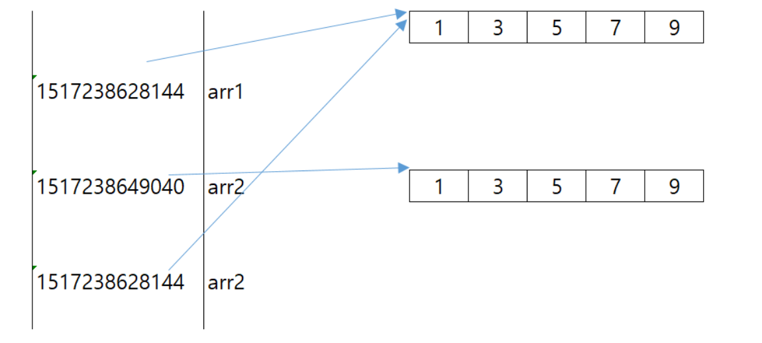
1.2. NumPy Array Basics
UNIT 01
We can see that the address values are the same.
1
3
5
7
9
2246716570240
arr1
2247660678400
arr2
1
3
5
7
9
2246716570240
arr3
arr3

Slide 36
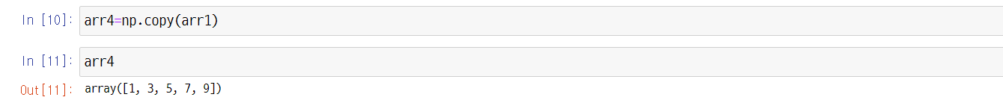
1.2. NumPy Array Basics
UNIT 01
If you want to copy only the value, you can use np.copy(). See help(np.copy) for more detail.
Then let’s check the address value.
Line 12
Since only the value was copied, you can see that the address value is different.

Slide 37
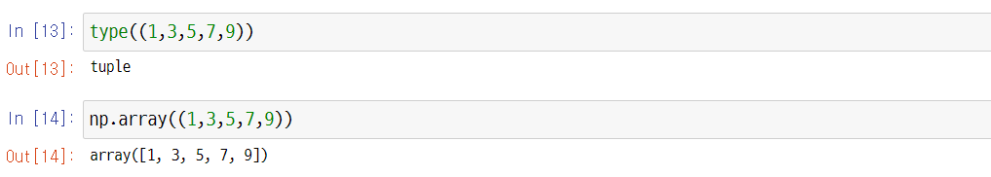
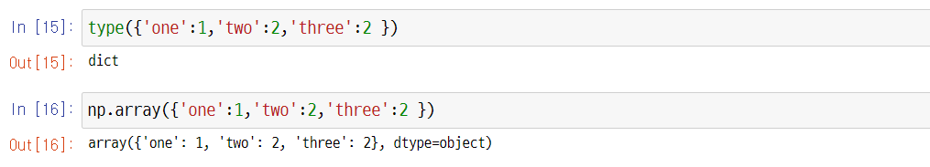
1.2. NumPy Array Basics
UNIT 01
Creating Arrays with Tuples
Creating Arrays with Dictionaries

Slide 38
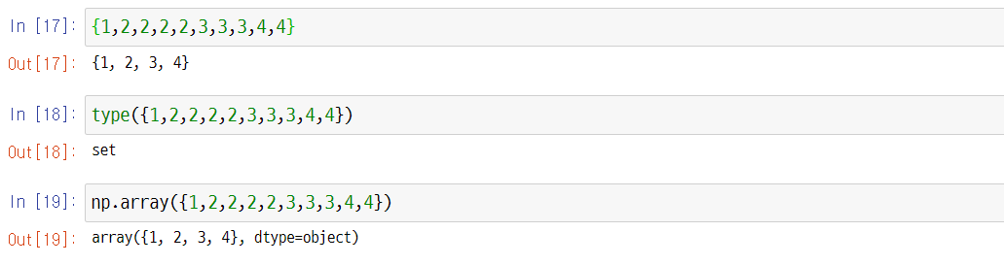
1.2. NumPy Array Basics
UNIT 01
Creating Arrays with Sets
Normally, lists are commonly used to create arrays.

Slide 39
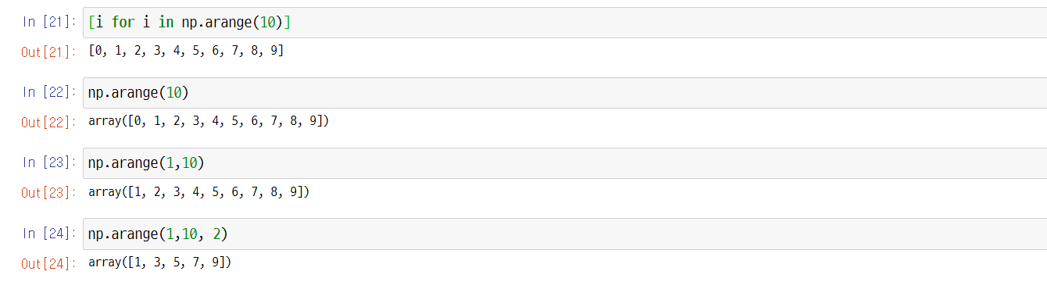
1.2. NumPy Array Basics
UNIT 01
Creating Arrays with arange
This is the same concept as the range in standard Python.
For NumPy arrays, use np.arrange.

Slide 40
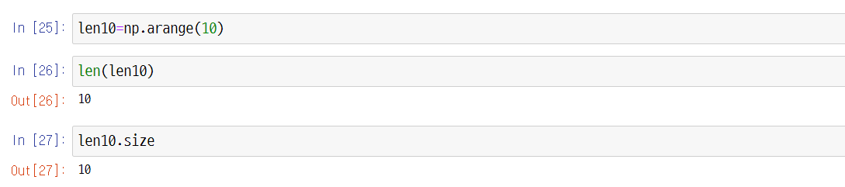
1.2. NumPy Array Basics
UNIT 01
Use the len() method and the size property for the size of the array.

Slide 41
1.2. NumPy Array Basics
UNIT 01
The NumPy array deals with each element by converting it to the same data type. (1/3)
The important thing is that the NumPy arrays process the same type quickly and effectively, as one of its characteristics.
However, although arrays can be made with different types of arrays, each type is converted into the same type.
Line 28
Different types of arrays can be created, such as integers, floats, and Booleans.

Slide 42
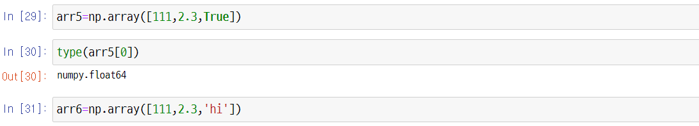
1.2. NumPy Array Basics
UNIT 01
The NumPy array deals with each element by converting it to the same data type. (2/3)
Due to the . in the integer type, the array is converted into a float when integer, float, and Boolean types are together.
Line 30
The data type of NumPy is returned in NumPy.datatype format.
Line 31
Different types of arrays are created, such as integers, floats, and strings.

Slide 43
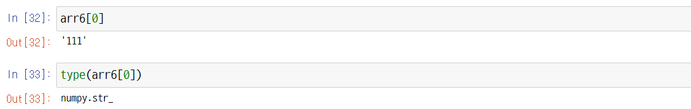
1.2. NumPy Array Basics
UNIT 01
The NumPy array deals with each element by converting it to the same data type. (3/3)
Line 33
Due to the '111’ in the integer type, the array is converted into a string when integer, float, and string types are together.

Slide 44
1.2. NumPy Array Basics
UNIT 01
The Data Types of NumPy Arrays are as follows:
Data Type | Explanation
int8, int16, int32, int64, int_ uint8, uint16, uint32, uint64 | Integer
float16, float32, float64, float128, float_ | Floating point
bool_ | Boolean
string_, unicode_ | String
The 8 in int8 is 8 bitss, which is the range of values that this value can represent.
https://docs.scipy.org/doc/NumPy-1.17.0/reference/arrays.dtypes.html

Slide 45
1.2. NumPy Array Basics
UNIT 01
Explanation of 8 bits
Since the bit represents two values, 8 bits can become 2 to the power of 8, representing up to 256 integers. In integers, this value ranges from -128 to 127. The range is up to 127, and not 128, because zero is excluded.
If only positive values are used, the space in the range of negative numbers needs to be crossed over to positive numbers. At this time, u, the first letter of the unsigned (meaning positive), is used.
Therefore, uint8 ranges from 0 to 255.

Slide 46
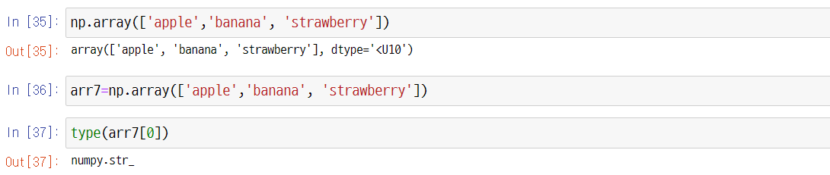
1.2. NumPy Array Basics
UNIT 01
Data Types of NumPy Arrays
Line 35
The U10, here, represents Unicode, and the < symbol represents 10byte or less.

Slide 47
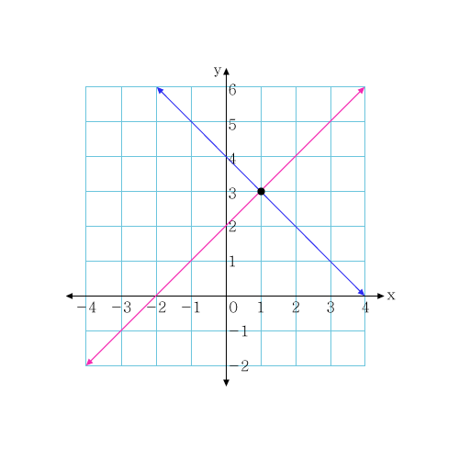
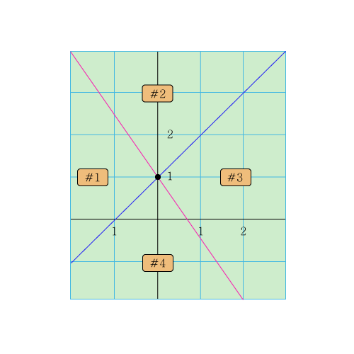
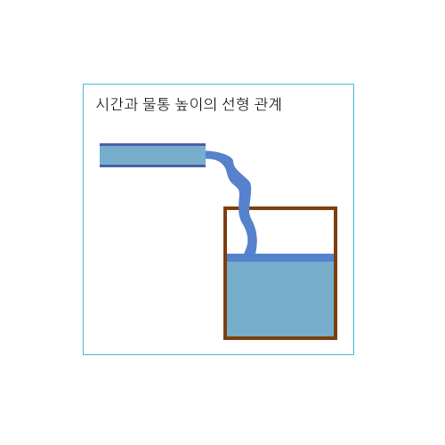
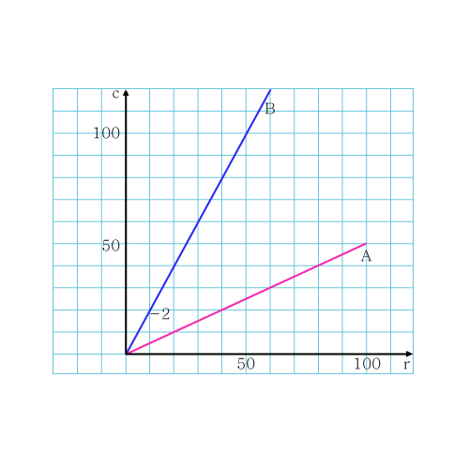
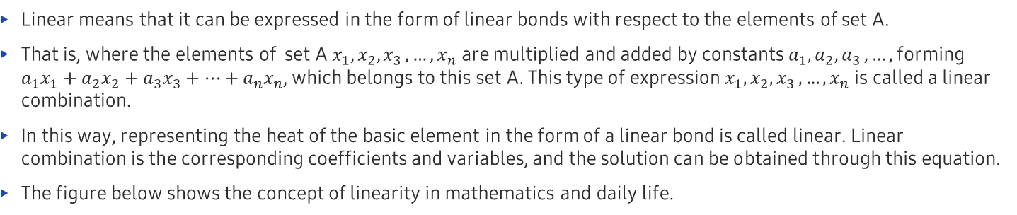
1.2. NumPy Array Basics
UNIT 01
Creating Arrays with the linspace Function (1/2) – See help(np.linspace) for more detail.
Linear means that it can be expressed in the form of linear bonds with respect to the elements of set A.
That is, where the elements of set A $x_{1},x_{2}{,x}_{3},…,x_{n}$ are multiplied and added by constants $a_{1},a_{2}{,a}_{3},…,$ forming $a_{1}x_{1}+a_{2}x_{2}+a_{3}x_{3}+…+a_{n}x_{n}$, which belongs to this set A. This type of expression $x_{1},x_{2}{,x}_{3},…,x_{n}$ is called a linear combination.
In this way, representing the heat of the basic element in the form of a linear bond is called linear. Linear combination is the corresponding coefficients and variables, and the solution can be obtained through this equation.
The figure below shows the concept of linearity in mathematics and daily life.
Linear relationship between time and the height of the water bottle

Slide 48
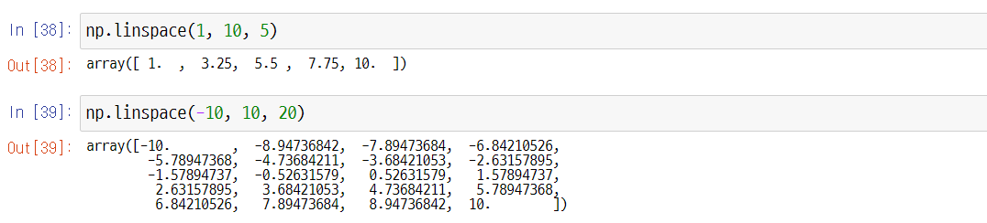
1.2. NumPy Array Basics
UNIT 01
Creating Arrays with the linspace Function (2/2)
Line 38
Five numbers in the linear space from 1 to 10.
Line 39
20 numbers in the linear space from 10 to 10.

Slide 49
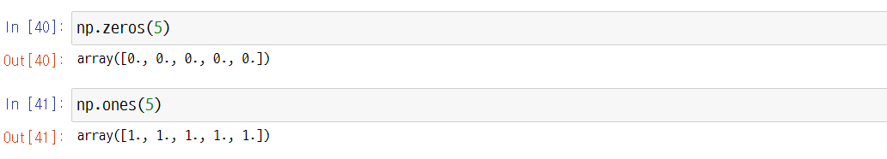
1.2. NumPy Array Basics
UNIT 01
Creating Arrays with np.zeros() and np.ones()
Line 40
Be careful not to skip the “s.”

Slide 50
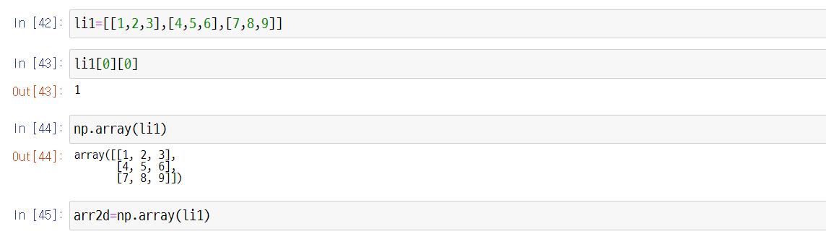
1.2. NumPy Array Basics
UNIT 01
Multidimensional Arrays
A multidimensional array refers to an array of two or more dimensions. It can be made in the form of a list in the list.
Line 43
The first element in this list is also a list, so the first element in that list is 1.
Line 44
Two-dimensional Array

Slide 51
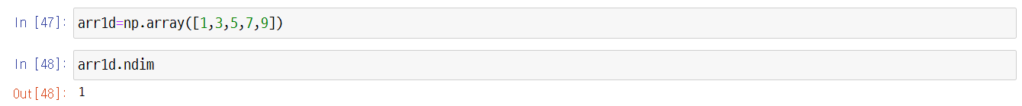
1.2. NumPy Array Basics
UNIT 01
Check the dimensions of the array with ndim.
Then, let’s check the one-dimensional array that we learned before.

Slide 52
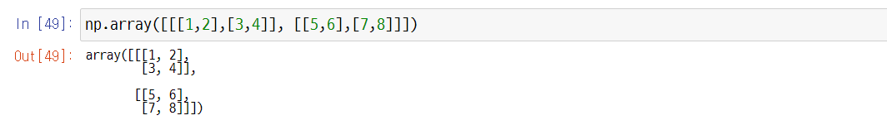
1.2. NumPy Array Basics
UNIT 01
We will also make a three-dimensional array.
5
6
1
7
8
2
3
4

Slide 53
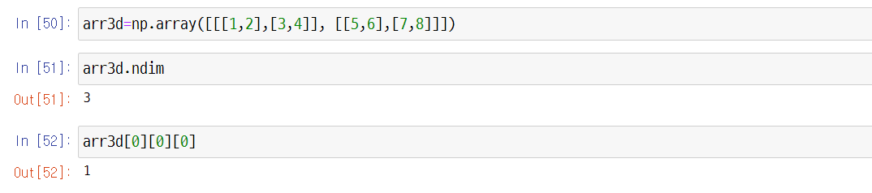
1.2. NumPy Array Basics
UNIT 01
Three-Dimensional Array
Line 50
A surface is two-dimensional and can be stacked. It’s easy to understand if you think of the surface as a piece of paper.
Line 52
When extracting a three-dimensional value, it’s easier to think of it as a method of approaching step by step.

Slide 54
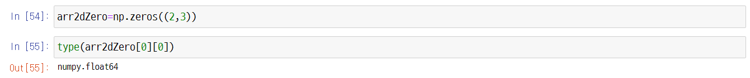
1.2. NumPy Array Basics
UNIT 01
Creating two-dimensional shapes using np.zeros()
Line 53
Designate it as two rows and three columns in the form of a tuple.
When created, the element within it is normally a float.

Slide 55
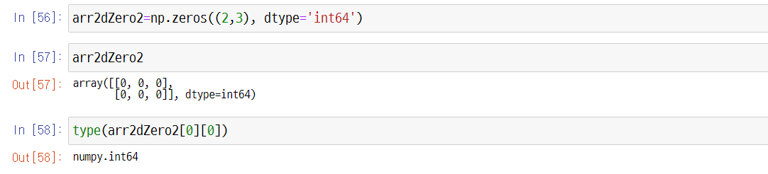
1.2. NumPy Array Basics
UNIT 01
If it is created by a different type, designate the parameter name using dtype.

Slide 56
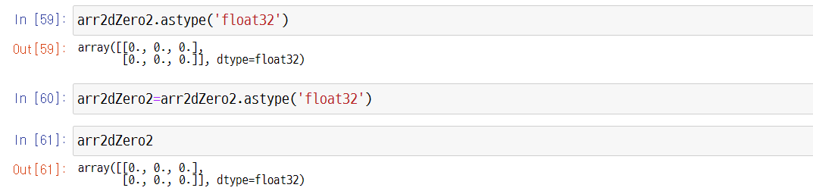
1.2. NumPy Array Basics
UNIT 01
Use the astype() method if you want to change the type to a float.

Slide 57
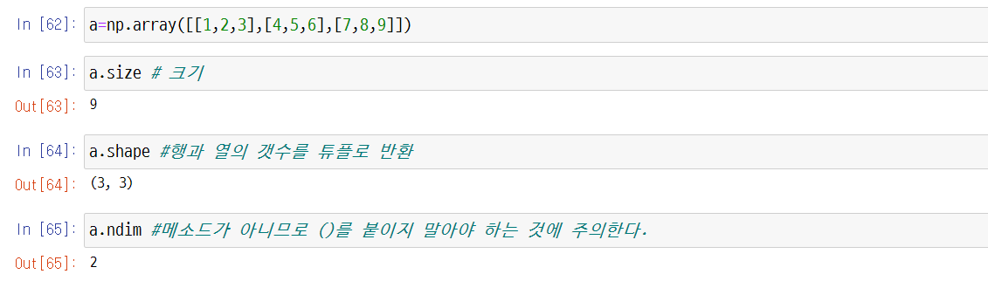
1.2. NumPy Array Basics
UNIT 01
Properties of the NumPy Array
Explanation of Each Property
Note that since it is not a method, () should not be attached.
Line 63
Size
Line 64
Converting the row and columns into a tuple

Slide 58
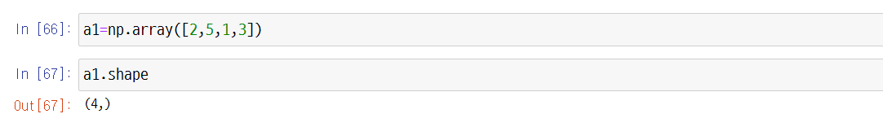
1.2. NumPy Array Basics
UNIT 01
It should be noted that for one-dimensional arrays, the tuples return the number of elements.

Slide 59
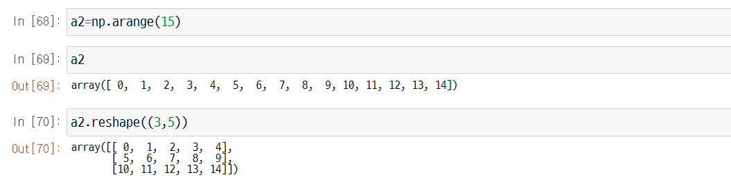
1.2. NumPy Array Basics
UNIT 01
Reshape
How to Reshape
Line 70
Be sure to input the shape as a tuple.

Slide 60
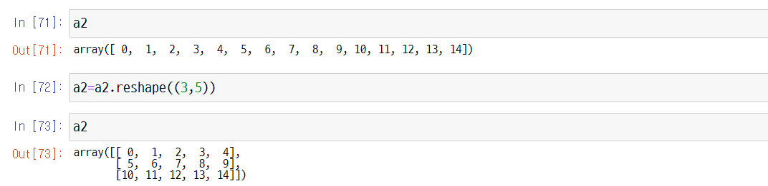
1.2. NumPy Array Basics
UNIT 01
Checking the shape of the object
Line 71
When checked, the shape of the object remains the same. Thus, it should be assigned again to create a new object.

Slide 61
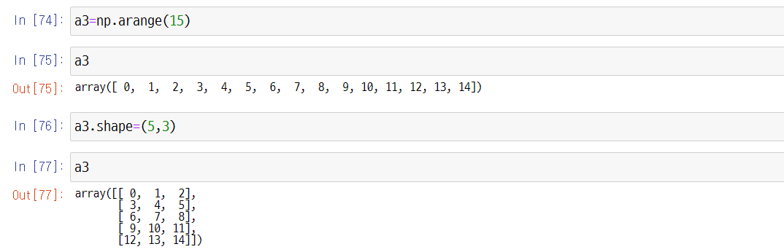
1.2. NumPy Array Basics
UNIT 01
The shape can be changed directly.

Slide 62
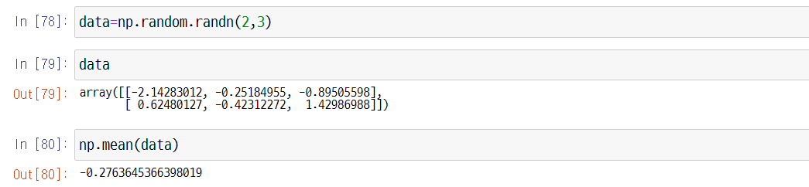
1.2. NumPy Array Basics
UNIT 01
Random Numbers
Data following the standard normal distribution (average 0, standard deviation 1) is generated as random numbers. See help(np.random.randn) for more detail.
Line 78
The generated data follows the standard normal distribution with shapes in two rows and three columns.
Notes:
A special case of the Normal probability density is that of the Standard Normal probability density.
In this case, you have $μ=0$ and $σ=1$.
Normal distribution will be explained in detail in Unit 2 of Chapter 4

Slide 63
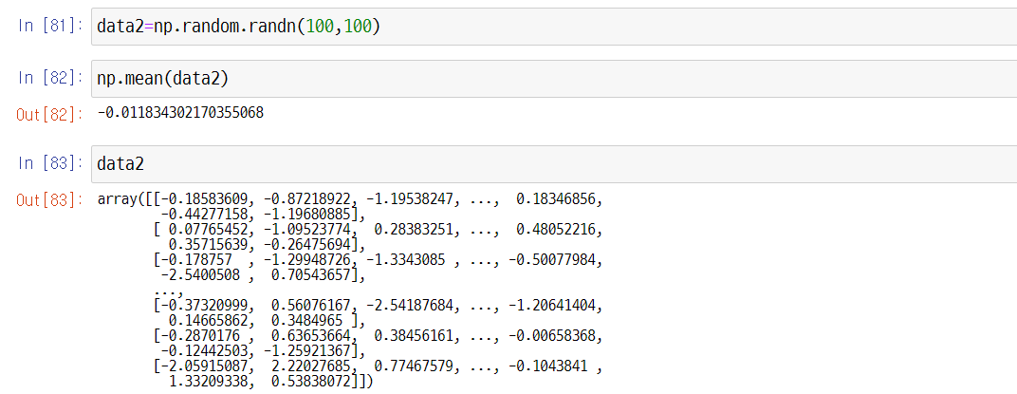
1.2. NumPy Array Basics
UNIT 01
Creating data2 with 100 rows and 100 columns

Slide 64
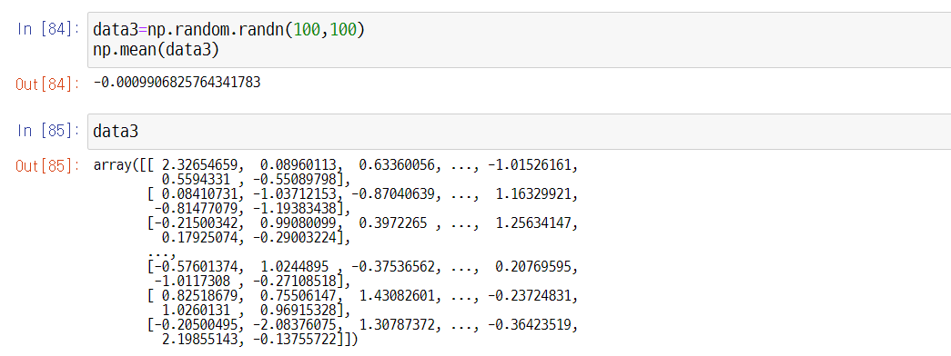
1.2. NumPy Array Basics
UNIT 01
Go ahead and create data3 as well.
The average is close to zero but not completely zero. If more data is generated, then the results get closer to zero.

Slide 65
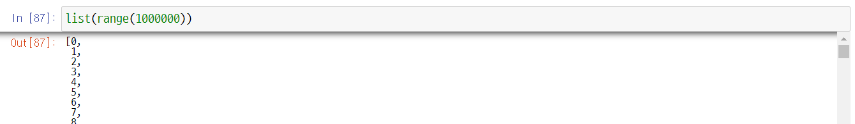
1.2. NumPy Array Basics
UNIT 01
Comparing Python Lists vs. NumPy Arrays: Processing Speed (1/4)
Let’s compare a Python list and a NumPy array that stores a million integers.
If you run the example below, you can see that the code using NumPy is much faster than the code written with pure Python.
By approaching np objects, denoted by abbreviating NumPy, you can create 1 million arrays starting from 0 using the arange method.
Here is a data structure of the list for comparison's sake.

Slide 66
1.2. NumPy Array Basics
UNIT 01
Comparing Python Lists vs. NumPy Arrays: Processing Speed (2/4)
Line 88
It returns the result in the form of NumPy.ndarray. This means that there is an array with n-dimensions.

Slide 67
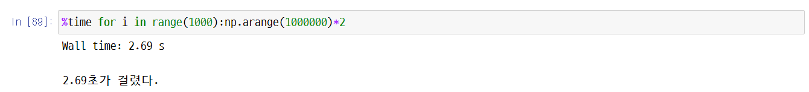
1.2. NumPy Array Basics
UNIT 01
Comparing Python Lists vs. NumPy Arrays: Processing Speed (3/4)
The following shows the speed of the Python array and the operation of multiplying each value of 1 million lists by 2, 1000 times.
%time is an IPython magic command that returns a single execution time. This magic command is a special command designed to easily control general tasks and other operations in the IPython system.
Magic commands are labeled with a % sign.
It took 46.5 seconds. There is a difference of more than 20 times.
Once again, it is important to understand the pros and cons of the arrays and lists we learned earlier to perform large-scale Big Data AI operations in the future. This would be a clear reason why we must learn and use NumPy when operating with such operations.

Slide 68
1.2. NumPy Array Basics
UNIT 01
Comparing Python Lists vs. NumPy Arrays: Processing Speed (4/4)
The results may differ in each user’s system, as we just saw on the screen.
Wall time, also called Wall-clock time, is the sum of the entire time it takes for the program to run and end, including CPU, I/O, Sub Program, etc.
To summarize vectorization once more, vectorization is one of the biggest reasons for using NumPy.
Vectorization is the operation of placing data without using loops or indexing.
NumPy’s vectorization optimizes the placement operation with compiled C code by performing it out of sight. For example, the loop statement code for calculating the weight of machine learning uses NumPy vectorization.

Slide 69
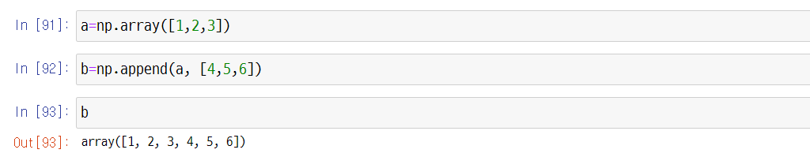
1.2. NumPy Array Basics
UNIT 01
Adding Elements to NumPy Arrays
A value is added to the one-dimensional data. The rank of the first-dimension is 1. See help.(np.append) for more detail.

Slide 70
1.2. NumPy Array Basics
UNIT 01
NumPy.append() method (1/3)
You can extend a NumPy array by calling the NumPy.append() method. Note that, unlike the lists, the plus ‘+’ operator cannot be used for this purpose.
When an array has orientations, you can specify the directions. For a 2D array, the axis argument set to 0 means vertical extension, while 1 means horizontal extension.
NumPy.append() provides just a view. For the changes to remain, the result should be assigned to a variable.

Slide 71
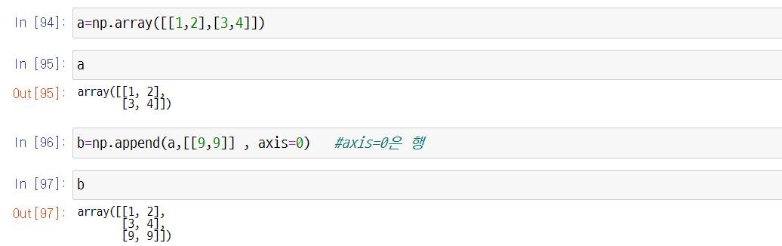
1.2. NumPy Array Basics
UNIT 01
NumPy.append() method (2/3)
Line 96
axis=0 is a row.

Slide 72
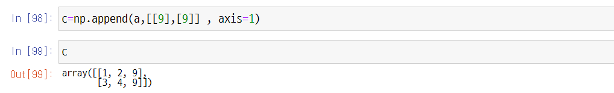
1.2. NumPy Array Basics
UNIT 01
NumPy.append() method (3/3)
Line 98
axis=1 is a column.

Slide 73
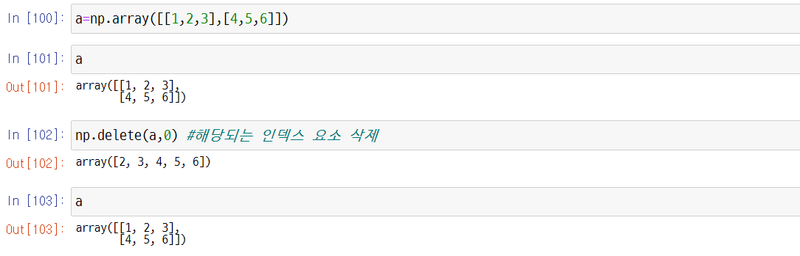
1.2. NumPy Array Basics
UNIT 01
Deleting Elements from NumPy Arrays
Method of Deleting Elements from Arrays (1/2)
Line 102
Delete the corresponding index element.
Line 103
Although the element was deleted, the array remains the same because no assignment was made.

Slide 74
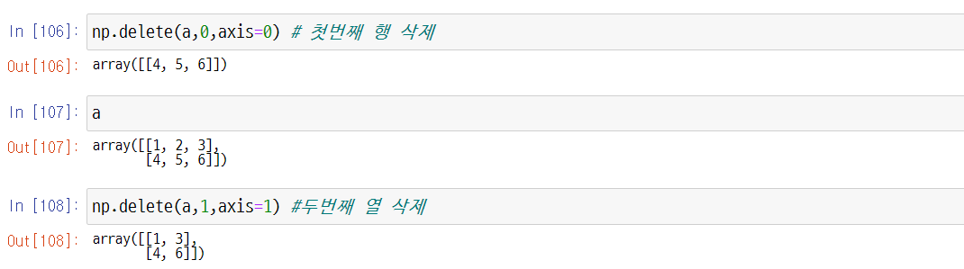
1.2. NumPy Array Basics
UNIT 01
Method of Deleting Elements from Arrays (2/2)
Line 106
Delete the first row.
Line 108
Delete the second column.

Slide 75
Unit 1.
NumPy Array Data Structure for Optimal Computational Performance
1.1. NumPy Arrays
1.2. NumPy Array Basics
1.3. NumPy Array Operations
1.4. NumPy Indexing and Slicing
1.5. Array Transposition and Axis Swap

Slide 76
1.3. NumPy Array Operations
UNIT 01
Basic Operations
We learned earlier that the unique feature of the NumPy array operation is that data can be processed collectively without using a for loop statement, which is called vectorization. In this case, arithmetic operations between arrays of the same size are applied in each element unit of the array.
For this reason, popular machine learning and deep learning libraries, such as scikit-learn, TensorFlow, PyTorch, etc., were all made based on NumPy.
This is a summary of the characteristics of NumPy that we’ve learned so far.
A low-level, high-performance library implemented in C
Supports fast, memory-effective multidimensional array ndarray operations
Supports various computational functions such as linear algebra, random number generator, Fourier transform, etc.

Slide 77
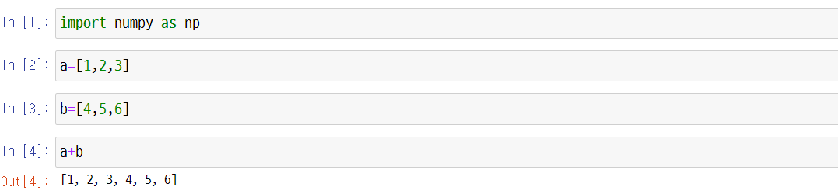
1.3. NumPy Array Operations
UNIT 01
Comparing Python Lists and NumPy Arrays: + Operator
Line 4
In a list, the + operator means connecting the given elements.

Slide 78
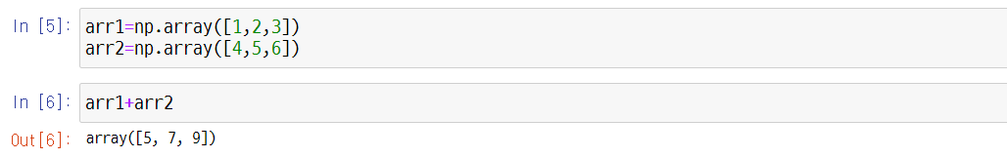
1.3. NumPy Array Operations
UNIT 01
Comparing Python Lists and NumPy Arrays: + Operator
Line 6
In a NumPy array, each element is calculated.

Slide 79
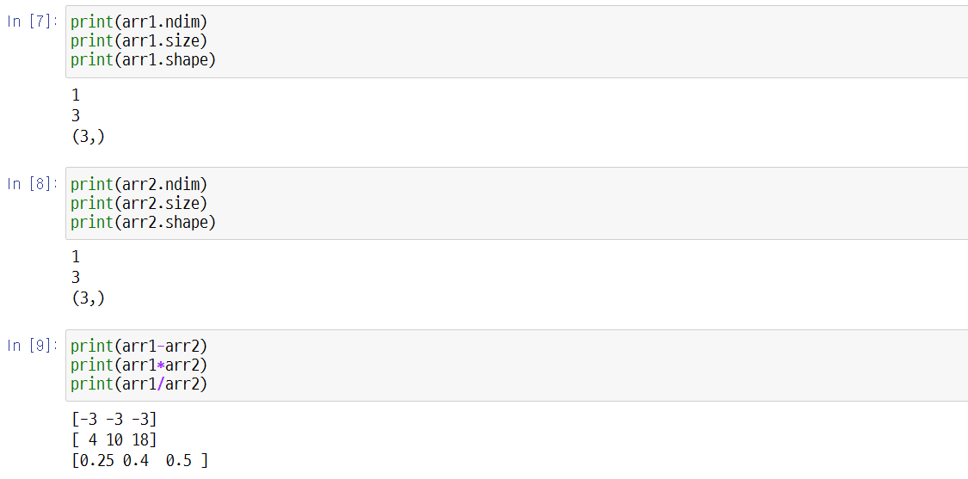
1.3. NumPy Array Operations
UNIT 01
If the shape of the array is the same, you can perform addition, subtraction, multiplication, and division operations.

Slide 80

1.3. NumPy Array Operations
UNIT 01
Comparing Python Lists and NumPy Arrays: Multiplication
Line 10
In a list, the * operator means repetition.
Line 11
Multiplication in a NumPy array returns the multiplication result of each element.

Slide 81

1.3. NumPy Array Operations
UNIT 01
repeat & tile
Line 14
In NumPy, the repeat method is used to repeat each element.
Line 15
In NumPy, the tile method is used for repeating the array.

Slide 82

1.3. NumPy Array Operations
UNIT 01
When using the tile method, the array can be repeated into a two-dimensional form.

Slide 83

1.3. NumPy Array Operations
UNIT 01
Arrays can also perform exponential operations.

Slide 84

1.3. NumPy Array Operations
UNIT 01
The array can also perform comparison operations. After checking whether each element matches the conditions, it returns True if there is a match and False if otherwise.

Slide 85

1.3. NumPy Array Operations
UNIT 01
Universal Functions (1/3)
Universal functions operate element by element on whole arrays. See help(np.ufunc) for more detail.
1.3. NumPy Array Operations

Slide 86
1.3. NumPy Array Operations
UNIT 01
Universal Functions (2/3)
NumPy functions:
Function | Explanation | Universal function?
sin, cos, tan | Trigonometric functions | Yes
arcsin, arccos, arctan | Inverse trigonometric functions | Yes
round | Round to a given number of decimals | Yes
floor | Returns the nearest smaller integer | Yes
ceil | Returns the nearest greater integer | Yes
fix | Returns the nearest integer closer to 0 | Yes
prod | Returns the product of the array elements | No
cumsum | Returns the cumulative sums of an array | No
sum, mean, var, std, median | Statistical functions | No
exp, log | Exponential and logarithmic functions | Yes
unique | Returns the unique values of an array | No
min, max, argmax, argmin | Minimum, maximum, and the corresponding indices | No
https://docs.scipy.org/doc/NumPy-1.17.0/reference/

Slide 87
1.3. NumPy Array Operations
UNIT 01
Universal Functions (3/3)
Statistical methods of NumPy arrays:
Method | Explanation
mean | Average
var | Variance
std | Standard deviation
sum | Total sum
cumsum | The cumulative sums of an array
max, min | The maximum and the minimum of an array
argmax, argmin | Indices of the maximum and the minimum
https://docs.scipy.org/doc/NumPy-1.17.0/reference/

Slide 88

1.3. NumPy Array Operations
UNIT 01
Statistical methods of NumPy arrays:
Line 33
Sum
Line 34
Average

Slide 89

1.3. NumPy Array Operations
UNIT 01
Statistical methods of NumPy arrays:
Line 35
Average 5.5
Line 36
Deviation (difference from average)
Line 37
Square of Deviation

Slide 90

1.3. NumPy Array Operations
UNIT 01
Statistical methods of NumPy arrays:
Line 39
Sum of Squared Deviation

Slide 91

1.3. NumPy Array Operations
UNIT 01
Statistical methods of NumPy arrays:
Line 40
The sum of the squared deviations divided by the number of arrays is called a variance.
This result can be calculated directly through the process above, or the var() can be used.
Line 42
The square root of the variance is the standard deviation.

Slide 92
1.3. NumPy Array Operations
UNIT 01
Statistical methods of NumPy arrays:
Line 40
The sum of the squared deviations divided by the number of arrays is called a variance.
This result can be calculated directly through the process above, or the std() method can be used.

Slide 93
1.3. NumPy Array Operations
UNIT 01
Statistical methods of NumPy arrays:
Line 44
The cumsum() method is used to find the cumulative sum of x.

Slide 94

1.3. NumPy Array Operations
UNIT 01
Statistical methods of NumPy arrays:
Line 47
In this way, you can designate it as two rows and three columns. However, if you designate only a row, use -1 to change the rest on its own.

Slide 95

1.3. NumPy Array Operations
UNIT 01
Statistical methods of NumPy arrays:
Statistical functions can also be used for each row and column.
Line 52
The average of 1 and 4 is 2.5. When the axis = 0, the operation is carried out along the columns.
Line 53
The average of 1, 2, and 3 is 2. When the axis = 1, the operation is carried out along the rows.

Slide 96
1.3. NumPy Array Operations
UNIT 01
About Random Numbers in NumPy
Line 54
Initializing the seed value using np.ramdom will generate a fixed random number when generating random number values.
Notes:
Setting np.random.seed() to a fixed value generates uniform random numbers.
Run the codes below. You can see that the same seed generates the same set of numbers and using a different seed produces different set of numbers.
When setting the seed to a same value, same random numbers are generated in order.
np.random.seed(0)
print(np.random.random(3))
np.random.seed(2)
print(np.random.random(3))
np.random.seed(0)
print(np.random.random(3))

Slide 97

1.3. NumPy Array Operations
UNIT 01
About Random Numbers in NumPy
Return random integers from ‘low’ (inclusive) to ‘high’ (exclusive). Refer to help(np.random.randint).
Line 55
A random number is returned from integers 0 to 9.
Line 56
This is how you would return a random number from integers 1 to 10.

Slide 98

1.3. NumPy Array Operations
UNIT 01
About Random Numbers in NumPy
Write the code below to check if the code will return 10 every time.

Slide 99


1.3. NumPy Array Operations
UNIT 01
About Random Numbers in NumPy
Line 58
In this case, 11 is not returned, so it repeats indefinitely. Click (interrupt kernel) to stop the repetition.

Slide 100

1.3. NumPy Array Operations
UNIT 01
Final Summary
Universal functions:

Slide 101

1.3. NumPy Array Operations
UNIT 01
Final Summary
NumPy functions:

Slide 102

1.3. NumPy Array Operations
UNIT 01
Final Summary
NumPy functions:
Line 65
Returns only unique values that are not repeated.

Slide 103

1.3. NumPy Array Operations
UNIT 01
Final Summary
NumPy functions:
Line 68
Rounded up to the second decimal place.

Slide 104

1.3. NumPy Array Operations
UNIT 01
Final Summary
NumPy functions:

Slide 105

1.3. NumPy Array Operations
UNIT 01
Final Summary
NumPy functions:

Slide 106

1.3. NumPy Array Operations
UNIT 01
Final Summary
Universal functions:
Line 77
Returns the index location with the highest value into an integer.
Line 78
Returns the index location with the lowest value into an integer.

Slide 107
1.3. NumPy Array Operations
UNIT 01
Linear Algebra of the NumPy Array
NumPy supports not only simple operations of arrays but also matrix (two-dimensional array) operations for linear algebra.
Among the various methods, let’s first look at how to obtain matrix multiplication, transpose matrix, inverse matrix, and determinant.

Slide 108
1.3. NumPy Array Operations
UNIT 01
Matrix Operations
The following is the method for obtaining matrix product, transpose matrix, inverse matrix, and determinant for matrices A and B.
matrix product
transpose matrix
inverse matrix
determinant
Notes:
수학부분에서 이미 자세히 다루었다.

Slide 109

1.3. NumPy Array Operations
UNIT 01
Matrix Operations
For matrix operations, make 2x2 matrices A and B as follows:

Slide 110

1.3. NumPy Array Operations
UNIT 01
Matrix Operations
Example of the product of matrices A and B (A*B). Both methods can be used.

Slide 111

1.3. NumPy Array Operations
UNIT 01
Matrix Operations
The following is an example of finding the transpose matrix of matrix A. Both methods can be used.

Slide 112
1.3. NumPy Array Operations
UNIT 01
Matrix Operations
How to find the inverse matrix of matrix A
An example of obtaining a determinant of matrix A

Slide 113

1.3. NumPy Array Operations
UNIT 01
Coding Exercise #0101
Follow practice steps on ‘ex_0101.ipynb' file
Notes:
WHAT THIS PRACTICE ABOUT
In this practice, you learn how to create NumPy arrays and work with their attributes.
PRACTICE INSTRUCTION
Click Window button.
Search the “anaconda prompt” and Run.
Type the command "jupyter notebook" and press Enter.
In Jupyter Notebook, go to the folder containing the practice files. (If you don’t have practice files yet, ask your instructor)
Click Coding Exercise folder.
Click the ex_0101.ipynb file.
Review the examples on the topics below:
NumPy library.
NumPy basics.
Creating NumPy arrays.
Indexing and slicing NumPy arrays.
NumPy attributes and reshaping.
Modifying NumPy arrays.
(Optional) Use the blank cell at the bottom to practice your own personal needs.

Slide 114
1.3. NumPy Array Operations
UNIT 01
Coding Exercise #0102
Follow practice steps on ‘ex_0102.ipynb' file
Notes:
WHAT THIS PRACTICE ABOUT
In this practice, you learn how to create NumPy arrays and work with their attributes.
PRACTICE INSTRUCTION
Click Window button.
Search the “anaconda prompt” and Run.
Type the command "jupyter notebook" and press Enter.
In Jupyter Notebook, go to the folder containing the practice files. (If you don’t have practice files yet, ask your instructor)
Click Coding Exercise folder.
Click the ex_0102.ipynb file.
Review the examples on the topics below:
NumPy library.
NumPy basics.
Creating NumPy arrays.
Indexing and slicing NumPy arrays.
NumPy attributes and reshaping.
Modifying NumPy arrays.
(Optional) Use the blank cell at the bottom to practice your own personal needs.

Slide 115
Unit 1.
NumPy Array Data Structure for Optimal Computational Performance
1.1. NumPy Arrays
1.2. NumPy Array Basics
1.3. NumPy Array Operations
1.4. NumPy Indexing and Slicing
1.5. Array Transposition and Axis Swap

Slide 116
1.4. NumPy Indexing and Slicing
UNIT 01
Indexing and Slicing
Selecting elements in an array by specifying the location or condition of an array is called indexing. And selecting elements in an array by specifying a range is called slicing.
To select an element at a specific location in a one-dimensional array, the element’s position must be specified as shown below, and the element in the array starts at 0.
Array Name[Location]
Indexing
The first
-5
-4
-3
-2
-1
0
1
2
3
4
The last

Slide 117

1.4. NumPy Indexing and Slicing
UNIT 01
Indexing
Indexing a one-dimensional array is like Python list indexing.

Slide 118

1.4. NumPy Indexing and Slicing
UNIT 01
Indexing
Multi-dimensional arrays can also be approached like list indexing.
Line 5
Can access one specific multi-dimensional value.

Slide 119
1.4. NumPy Indexing and Slicing
UNIT 01
Indexing
Unlike list indexing, dimensions can be divided into commas (,) and approached in a multidimensional array. The dimension divided by commas is called an axis. Since b is a two-dimensional array, we can treat it as a matrix. Vales in columns 1 and 2 can be accessed as on the previous page.
It can also be approached as shown below.

Slide 120

1.4. NumPy Indexing and Slicing
UNIT 01
Indexing
Not only can the array’s elements be imported, but the value of the corresponding index can be changed as follows.

Slide 121
1.4. NumPy Indexing and Slicing
UNIT 01
Indexing
To select multiple elements from a one-dimensional array, store them as follows.
The outer brackets are brackets for indexing, and the inner brackets are brackets for the list.
Array name [[]]
Array name [[position 1, position 2, ..., position n]]
Line 10
Elements 10, 30, and 40 located at positions 1, 3, and 4 were taken from the one-dimensional array a1.

Slide 122

1.4. NumPy Indexing and Slicing
UNIT 01
Indexing
To select an element at a specific location in a two-dimensional array, specify the positions of rows and columns as follows.
Array name [row_position, column_position]
If only the array name [row_position] is entered without a “column_position,” the entire designated row is selected.
It is a method of selecting and importing a specific element by indexing in a two-dimensional array.

Slide 123

1.4. NumPy Indexing and Slicing
UNIT 01
Indexing
In the two-dimensional array a2, an element having a row_position of 0 and a column_position of 2 is selected and imported as follows.
As shown below, you can also change the value after selecting an element by specifying the positions of rows and columns in a two-dimensional array.

Slide 124

1.4. NumPy Indexing and Slicing
UNIT 01
Indexing
A method of obtaining the entire row by specifying the “row_position” in a two-dimensional array is shown below.
The entire row can also be changed by specifying a specific row in a two-dimensional array, as shown below.

Slide 125

1.4. NumPy Indexing and Slicing
UNIT 01
Indexing
To select several elements in a two-dimensional array, do as follows.
Array name [[row_position 1, row_position 2, …, row_position n],[column_position n], column_position 2, …, column_position n]]
The following is an example of selecting multiple elements by specifying the positions of rows and columns in a two-dimensional array.
Line 17
If you select the row first from [10, 20, 30] and the column from [45, 55, 65], then 10 and 55 are returned.

Slide 126

1.4. NumPy Indexing and Slicing
UNIT 01
Selecting the Array by Specifying the Conditions
Array Name[Condition]
Line 19
Only elements that meet the conditions of “a>3” are returned.
Line 20
Only even numbers are returned.

Slide 127
1.4. NumPy Indexing and Slicing
UNIT 01
Array Slicing
Instead of selecting one element through indexing, slicing selects a portion of the array by specifying a range.
For a one-dimensional array, slicing specifies the positions of the beginning and the end, as shown below.
Array[start_position]:end_position]
If the start position is not specified, the start position becomes 0, and the range becomes “0 to end position -1.” If the end position is not specified, the “end position” becomes the array’s length, and the range becomes “start_position to end of the array.”

Slide 128

1.4. NumPy Indexing and Slicing
UNIT 01
Slicing
In a one-dimensional array, slicing is performed without specifying a ”start_position” and an “end_position,” as shown below.

Slide 129

1.4. NumPy Indexing and Slicing
UNIT 01
Slicing
Now, let’s consider the case for a two-dimensional array.
Try slicing the array above.
Line 27
Choose from the beginning to the second line of “arr2d.”

Slide 130
1.4. NumPy Indexing and Slicing
UNIT 01
Slicing
It is also possible to slice multi-dimensional arrays by crossing several indices.
As shown above, slicing always gives a view of the array in the same dimension. An integer index and a slice can be used together to obtain a lower-dimension slice.
For example, if you want to select only the first two columns in the second row, do as follows.

Slide 131
1.4. NumPy Indexing and Slicing
UNIT 01
Slicing
If you select only the third column in the first two rows, do as follows.
If you just use a colon, you choose the entire axis, so the slice of the original dimension is returned.

Slide 132
1.4. NumPy Indexing and Slicing
UNIT 01
Slicing
 | Code | Form of Slice
 | arr[:2, 1:] | (2,2)
 | arr[2] arr[2, :] arr[2:, :] | (3,) (3,) (1,3)
 | arr[:, :2] | (3,2)
 | arr[1, :2] arr[1:2, :2] | (2,) (1,2)

Slide 133

1.4. NumPy Indexing and Slicing
UNIT 01
Selecting in Boolean Values
This Boolean array determines whether the name “Bob” is in the names array.
By indexing under this condition, only those whose name is “Bob” can be returned.

Slide 134

1.4. NumPy Indexing and Slicing
UNIT 01
Fancy Indexing
Return a new array of given shape and type without initializing entries. See help(np.empty) for more detail.

Slide 135

1.4. NumPy Indexing and Slicing
UNIT 01
Fancy Indexing
Selecting rows in a specific order can skip the ndarrray or the list containing the desired order.
If you use negative numbers as an index, select a row from the end.

Slide 136

1.4. NumPy Indexing and Slicing
UNIT 01
Fancy Indexing
To index values that are only multiples of 5, the Boolean array for the condition can be put into the variable and obtained.

Slide 137


1.4. NumPy Indexing and Slicing
UNIT 01
Fancy Indexing
It can also be obtained by combining two conditions.

Slide 138
Unit 1.
NumPy Array Data Structure for Optimal Computational Performance
1.1. NumPy Arrays
1.2. NumPy Array Basics
1.3. NumPy Array Operations
1.4. NumPy Indexing and Slicing
1.5. Array Transposition and Axis Swap

Slide 139
1.5. Array Transposition and Axis Swap
UNIT 01
Array Transposition
Array Transposition is a special function that returns a view in which the data shape has changed without copying the data. ndarray has a transponse method and a special property named T.

Slide 140

1.5. Array Transposition and Axis Swap
UNIT 01
Array Transposition
Transpose can change the dimensional order of the ndarray. T can be used to reverse the order of all dimensions with transpose. Since this is a frequently used function, it was made into a shortcut function.

Slide 141

1.5. Array Transposition and Axis Swap
UNIT 01
Array Transposition
Linear algebra, such as matrix multiplication, division, determinant, and square matrix, is an important part of the library dealing with arrays.
Multiplying two two-dimensional arrays by * operators yields the product of each corresponding element, not the multiplication of the matrix.
Matrix multiplication is calculated using a dot function in the NumPy namespace and an array method.

Slide 142
1.5. Array Transposition and Axis Swap
UNIT 01
Array Transposition
It is often used in matrix calculation, and np.dot is also used to find the inner part of the matrix.
Notes:
You can check about the inner part of matrix in Unit 4 of Chapter 2.

Slide 143

1.5. Array Transposition and Axis Swap
UNIT 01
Array Transposition
First, let’s reshape 3 rows and 4 columns in 2D into 4 rows and 3 columns.

Slide 144

1.5. Array Transposition and Axis Swap
UNIT 01
Array Transposition
This time, let’s try with a three-dimensional array.
Even in a three-dimensional array, the transpose method receives the tuple axis number and replaces it.
Line 16
Second page, second row, fourth row.

Slide 145

1.5. Array Transposition and Axis Swap
UNIT 01
Array Transposition
Line 18
The order of the first and second axes was reversed, and the last axis remained the same.

Slide 146

1.5. Array Transposition and Axis Swap
UNIT 01
Array Transposition
There is a method called swapaxes in the ndarray, which receives two axis numbers and reverses the array.

Slide 147

1.5. Array Transposition and Axis Swap
UNIT 01
Array Transposition

Slide 148
1.5. Array Transposition and Axis Swap
UNIT 01
Coding Exercise #0103
Follow practice steps on ‘ex_0103.ipynb' file
Notes:
WHAT THIS PRACTICE ABOUT
In this practice, you learn how to create NumPy arrays and work with their attributes.
PRACTICE INSTRUCTION
Click Window button.
Search the “anaconda prompt” and Run.
Type the command "jupyter notebook" and press Enter.
In Jupyter Notebook, go to the folder containing the practice files. (If you don’t have practice files yet, ask your instructor)
Click Coding Exercise folder.
Click the ex_0103.ipynb file.
Review the examples on the topics below:
NumPy library.
NumPy basics.
Creating NumPy arrays.
Indexing and slicing NumPy arrays.
NumPy attributes and reshaping.
Modifying NumPy arrays.
(Optional) Use the blank cell at the bottom to practice your own personal needs.

Slide 149
Unit 2.
Optimal Data Exploration Through Pandas
2.1. Pipelines: Data Structures According to Data Types
2.2. Pandas Series and DataFrames
2.3. Merging and Binding DataFrames
2.4. DataFrame Sorting and Multi-Index
2.5. Examining the Characteristics of Data Through Descriptive Statistics and Data Samples

Slide 150
2.1. Pipelines: Data Structures According to Data Types
UNIT 02
Pipelines
Structural Perspective of Data Types
Collected data, from a structural perspective (schema structure or computability), can be divided into three categories: structured, unstructured, and semi-structured data.
Structured data refers to data that has a structure-based form of the structured schema (form) and is stored in fixed fields such as RDB and spreadsheet and is consistent in value and format.
Unstructured data refers to data that does not have a schema structure and is not stored in fixed fields such as social media, web bulletin boards, and NoSQL.
Semi-Structured data refers to data that has a schema(formal) structure and contains metadata such as XML, HTML, weblogs, system logs, and alarms and is inconsistent in value and format.

Slide 151
2.1. Pipelines: Data Structures According to Data Types
UNIT 02
Python Data Structure Pipeline
Data collected from various sources have various forms and properties, as shown in the figure below. Thus, for analysis, it is necessary to integrate various data types in the same format so that computers can understand them.
Source
Format
(Unstructured)
Form
Processing
Internet
plain text
List, Tuple, Set
CSV
Array, Matrix
File
HTML/XML
Frame, Series
JSON
Database
Dictionary
Table form
Structured

Slide 152
Unit 2.
Optimal Data Exploration Through Pandas
2.1. Pipelines: Data Structures According to Data Types
2.2. Pandas Series and DataFrames
2.3. Merging and Binding DataFrames
2.4. DataFrame Sorting and Multi-Index
2.5. Examining the Characteristics of Data Through Descriptive Statistics and Data Samples

Slide 153
2.2. Pandas Series and DataFrames
UNIT 02
Pandas Outline
A table is the most optimal form of data that a person can understand. Therefore, the ability to handle tabular data well is the basis of analysis. In Python, the table form is called a DataFrame and is implemented as a pandas library.
The pandas library is built based on NumPy but specializes in more complex data analysis.
While NumPy processes only the same array of data types, Pandas can process different data types.
The pandas library is an optimal tool for collecting and organizing data.
Pandas is an important tool that can handle most of the work in data science and is essential for data scientists.
Notes:
pandas is a must have library when dealing with data.
It is versatile and powerful. It is packed full of useful features.
It is no overstatement to say that you begin our journey in data science with the pandas library!

Slide 154
2.2. Pandas Series and DataFrames
UNIT 02
Pandas for Data Analysis
Essential Library for Data Analysis
Statistics-based effective representation and data collection summary
Data alignment and manipulation to merge and weave various types of data
Processing data such as collection, transformation, and function application can be applied to the entire data bundle.
Since NumPy is a general arithmetic data processing-based library, pandas must be used to process tabular data for statistics or analysis. Pandas also provides time series processing capabilities that NumPy lacks.

Slide 155
2.2. Pandas Series and DataFrames
UNIT 02
About Pandas Data Structure:
To learn about pandas, it is important to familiarize oneself with Series and DataFrame data structures.
The basic data structures of pandas include Series (1D) and DataFrame (2D). DataFrame is a container for Series, and Series is a container for scalar (0D). They can add or delete data in a dictionary manner.
Series
Series
Series
Series
Sex
Male
Female
Male
Male
Female
Female
Female
Bloodtype
3
2
4
3
1
2
1
Height
23
22
24
23
20
21
22
Weight
68.2
53
80.1
85.7
49.5
52
45.3
DataFrame

Slide 156
2.2. Pandas Series and DataFrames
UNIT 02
Series
A series is a form of sequentially listed one-dimensional arrays.
Since it is an array, all elements in the series must belong to one data type.
Simple series can be created from sequences such as lists, tuples, and arrays.
The word ‘series’ is singular AND plural. Its Latin origin, ’serere,’ means to join or connect.
The default value of the series is an integer index. The label of the first item is 0, the label of the second item is 1, and it increases in this manner.
The attribute value of the series is the list of all values in the series.
The attribute value of the index means an index of a series.
The attribute value of the index.values is an array of all index values.

Slide 157

2.2. Pandas Series and DataFrames
UNIT 02
How to Create a Series
Creating from a List

Slide 158

2.2. Pandas Series and DataFrames
UNIT 02
How to Create a Series
Creating from NumPy Arrays. See help(pd.Series) for more detail.

Slide 159

2.2. Pandas Series and DataFrames
UNIT 02
How to Create a Series
Series can also be created with array-like, Iterable, dict, or scalar value.
Line 6
We can know that the data type is a series.

Slide 160

2.2. Pandas Series and DataFrames
UNIT 02
How to Create a Series
To deal with DataFrames in the future, you must first understand the series data and think of the column part as a series in the figure below.
DataFrame
row
column

Slide 161

2.2. Pandas Series and DataFrames
UNIT 02
Creating a Series with Dictionary

Slide 162
2.2. Pandas Series and DataFrames
UNIT 02
Creating a Series with Dictionary
Index arrays can be selected separately using index attributes of the series class.
Selecting the data value array separately is also possible. At that time, the values attribute of the series class is used.

Slide 163

2.2. Pandas Series and DataFrames
UNIT 02
Creating a Series with List
Line 16
The index is represented by an integer-like RangeIndex object in the range of 0 and 4. At this time, the last value is not included.
The data value array maintains the order of the list element array of list_data, which is the original data.

Slide 164
2.2. Pandas Series and DataFrames
UNIT 02
DataFrame and Series
Let’s create a simple DataFrame and learn how to manipulate data in a series. This data stores passenger data of the Titanic. It is assumed that the passenger’s name (character), age (integer), and gender (male/female) data are known.
Name | Age | Sex
Braund, Mr. Owen Harris | 22 | male
Allen, Mr. William Henry | 35 | male
Bonnell, Miss. Elizabeth | 58 | female

Slide 165

2.2. Pandas Series and DataFrames
UNIT 02
DataFrame and Series
A data frame must be used to view the proceeding table and store data in the form of a table. The column name, also called a column header, is mainly set as a key value of a dictionary.

Slide 166
2.2. Pandas Series and DataFrames
UNIT 02
DataFrame and Series
A DataFrame is a two-dimensional data structure that stores various data types (letters, integers, floating point values, categorical data, etc.) in a column.
Each table has three columns with a column label. The column labels are “Name,” “Age,” and “Sex.”
Column “Name” consists of text data in which each value is a string, column “Age” is a silver number, and column “Sex” is text data.
It is similar to data table representation in a spreadsheet.

Slide 167

2.2. Pandas Series and DataFrames
UNIT 02
The column of a DataFrame is a series.
Series

Slide 168

2.2. Pandas Series and DataFrames
UNIT 02
The column of a DataFrame is a series.
If you are only interested in the “Age” column and want to pull out the column, use the dictionary key value.
Line 19
If you are familiar with dictionary, selecting a single column is very similar to selecting a dictionary value based on a key.

Slide 169
2.2. Pandas Series and DataFrames
UNIT 02
The column of a DataFrame is a series.
If you are only interested in the “Age” column and want to pull out the column, use the dictionary key value.
Line 21
It is possible to index a series.

Slide 170

2.2. Pandas Series and DataFrames
UNIT 02
The column of a DataFrame is a series.
Let’s make a DataFrame into a list of list types and organize it in a two-dimensional form.
Line 23
Since the column name is not specified, it appears as a RangeIndex object.

Slide 171

2.2. Pandas Series and DataFrames
UNIT 02
Creating a series by designating index
28
29
29
30
30
Line 29
Note that string data types in the series are recognized in the form of objects.

Slide 172

2.2. Pandas Series and DataFrames
UNIT 02
Creating a series by designating index
The attributes of the series are as follows.
Line 32
Designate the index name with the name attribute.

Slide 173

2.2. Pandas Series and DataFrames
UNIT 02
Creating a series by designating index

Slide 174

2.2. Pandas Series and DataFrames
UNIT 02
Creating a series by designating index
The methods of the series are as follows.

Slide 175

2.2. Pandas Series and DataFrames
UNIT 02
The methods of the series are as follows.
Line 39
Only non-duplicate values are returned.
Line 40
This is the number of values that are not duplicates.

Slide 176

2.2. Pandas Series and DataFrames
UNIT 02
The methods of the series are as follows.
Now, let’s try and duplicate the values.

Slide 177

2.2. Pandas Series and DataFrames
UNIT 02
The methods of the series are as follows.
Now, let’s try and duplicate the values.
Line 44
Only non-duplicate values are returned.
Line 46
Using the value_counts() method, the same value is added to the number. It’s a method that is used quite often, so be sure to remember it.

Slide 178

2.2. Pandas Series and DataFrames
UNIT 02
The methods of the series are as follows.
Series can be indexed and sliced like a NumPy array.

Slide 179

2.2. Pandas Series and DataFrames
UNIT 02
The methods of the series are as follows.
Operations in the series are also possible.

Slide 180

2.2. Pandas Series and DataFrames
UNIT 02
The methods of the series are as follows.
Operations in the series are also possible.
ser1 | ser2 | ser1+ser2
0 | 4 | 4
1 | 3 | 4
2 | 2 | 4
3 | 1 | 4
4 | 0 | 4

Slide 181

2.2. Pandas Series and DataFrames
UNIT 02
The methods of the series are as follows.
Operations in the series are also possible.
ser1 | ser2 | ser1*ser2
0 | 4 | 0
1 | 3 | 3
2 | 2 | 4
3 | 1 | 3
4 | 0 | 0

Slide 182

2.2. Pandas Series and DataFrames
UNIT 02
The methods of the series are as follows.
Operations in the series are also possible.

Slide 183

2.2. Pandas Series and DataFrames
UNIT 02
The methods of the series are as follows.
Methods Related to Statistics in the Series

Slide 184

2.2. Pandas Series and DataFrames
UNIT 02
The methods of the series are as follows.
Methods Related to Statistics in the Series

Slide 185

2.2. Pandas Series and DataFrames
UNIT 02
The methods of the series are as follows.
The lambda function can be applied to the series using the apply function.
Line 65
We will replace the lambda function with what we learned in Python Basics.
Line 67
Add 10 to each element and return it to the series.

Slide 186
2.2. Pandas Series and DataFrames
UNIT 02
Pandas Series and DataFrame Practice
Two-Dimensional Array
It was mentioned that DataFrame is a two-dimensional array consisting of rows and columns. The two-dimensional array is the most commonly used form of data for computers.
In the field of image processing and data analysis, most of the data are searched and processed in the form of a two-dimensional array. The DataFrame data structure of pandas originated from the DataFrame of R, a popular statistical package.
It is similar to the two-dimensional NumPy array. The data type of the column may be different. It is ideal for storing data from CSV files, Excel spreadsheets, SQL tables, etc. There are properties such as columns, indices, etc.
DataFrame can be thought of as a collection of Series objects. Pandas DataFrames allows for data representation similar to Excel spreadsheets.
DataFrame consists of rows and columns. Rows are observations or instances. Columns are variables.

Slide 187

2.2. Pandas Series and DataFrames
UNIT 02
Pandas Series & DataFrame Practice
pandas DataFrame is very convenient when reading an external data set, especially when data is stored in a comma-separated (CSV) format.

Slide 188

2.2. Pandas Series and DataFrames
UNIT 02
Pandas Series & DataFrame Practice
3
4
4

Slide 189

2.2. Pandas Series and DataFrames
UNIT 02
Pandas Series & DataFrame Practice
DataFrame objects can be created from dictionary objects.

Slide 190

2.2. Pandas Series and DataFrames
UNIT 02
Things to Check After Bringing in the DataFrame
df.info()
df.head()
This method prints information about a DataFrame, including the index dtype and columns, non-null values, and memory usage. See help(df.info) for more detail.

Slide 191

2.2. Pandas Series and DataFrames
UNIT 02
Things to Check After Bringing in the DataFrame
Line 9
It only shows the first five data. It is used to quickly view the state or value of the data.

Slide 192

2.2. Pandas Series and DataFrames
UNIT 02
Things to Check After Bringing in the DataFrame
Line 10
It only shows the last five data.

Slide 193
2.2. Pandas Series and DataFrames
UNIT 02
Things to Check After Bringing in the DataFrame
Line 11
Used to check the column name.
iris_df.columns() #caution: Since it is not a method, () is not used.

Slide 194
2.2. Pandas Series and DataFrames
UNIT 02
Things to Check After Bringing in the DataFrame
Line 12
Used the check index.

Slide 195

2.2. Pandas Series and DataFrames
UNIT 02
Things to Check After Bringing in the DataFrame
You can also change the column name, as shown below.
Line 14
You can see that it has changed from . to _.

Slide 196

2.2. Pandas Series and DataFrames
UNIT 02
Things to Check After Bringing in the DataFrame
Indexing and slicing are also possible in DataFrames.

Slide 197

2.2. Pandas Series and DataFrames
UNIT 02
Several columns are brought into the two-dimensional form, as shown below.

Slide 198
2.2. Pandas Series and DataFrames
UNIT 02
Pandas Series & DataFrame Practice
A DataFrame can also be created into a two-dimensional array. Let’s make the table below into a two-dimensional array of DataFrames.
Name | Age | Sex | School
Tom | 15 | Male | middle
Alice | 10 | Female | elementary

Slide 199

2.2. Pandas Series and DataFrames
UNIT 02
Pandas Series & DataFrame Practice
As shown above, the column name is not recognized when the data is entered. Thus, you have to set the columns yourself and create a DataFrame.

Slide 200

2.2. Pandas Series and DataFrames
UNIT 02
Pandas Series & DataFrame Practice

Slide 201
2.2. Pandas Series and DataFrames
UNIT 02
Pandas Series & DataFrame Practice
The row index and column name object of the df of the DataFrame, represented as df.index and df.columns, can be changed by assigning a new list to the attributes of the row index and column.
#Row Index Change: DataFrame Object.index = new row index list
#Column Name Change: DataFrame Object.columns = new column name list
There is no index at this time.

Slide 202

2.2. Pandas Series and DataFrames
UNIT 02
Pandas Series & DataFrame Practice

Slide 203

2.2. Pandas Series and DataFrames
UNIT 02
Pandas Series & DataFrame Practice
Columns can also be changed.

Slide 204
2.2. Pandas Series and DataFrames
UNIT 02
Pandas Series & DataFrame Practice
It is also possible to select and replace a row index or a part of the column name using the rename method in the DataFrame. It should be noted, however, that the original object is not directly modified, but a new DataFrame object is returned. Use the inplace= True option to change the original object.
# Row Index Change: DataFrame Object.rename(index={Existing index: New index,…})
# Column Name Change: DataFrame Object.renames=(columns={Existing Name: New Name,…})

Slide 205

2.2. Pandas Series and DataFrames
UNIT 02
Pandas Series & DataFrame Practice
Line 29
Looking at it again, notice that it didn’t change. Let’s try the inplace=True option.

Slide 206

2.2. Pandas Series and DataFrames
UNIT 02
Pandas Series & DataFrame Practice

Slide 207

2.2. Pandas Series and DataFrames
UNIT 02
Pandas Series & DataFrame Practice
If you don’t want to use the inplace=True option, you can reassign new objects with the same name, but it’s a bit cumbersome.
If you want to change the index 'stu2’ to 'student2’, do it as follows.

Slide 208

2.2. Pandas Series and DataFrames
UNIT 02
Pandas Series & DataFrame Practice
Column names can be created in the same way.
When changing 'student_name‘ to 'stu_name,’ the following two methods can be used.

Slide 209

2.2. Pandas Series and DataFrames
UNIT 02
Deleting Rows and Columns
When deleting a row or column of a DataFrame, use the drop() method. When deleting a row, enter Axis=0 as the axis option, or do not enter anything at all. On the other hand, if Axis=1 is entered as an axis option, the column is deleted. If you want to delete multiple rows or columns at the same time, enter them in the form of a list.
Delete Row: DataFrame Object.drop(row index or list, axis=0)
Delete Column: DataFrame Object.drop(column name or list, axis=1)
Line 36
Converting a DataFrame with a DataFrame() function. Save to variable df.

Slide 210

2.2. Pandas Series and DataFrames
UNIT 02
Deleting Rows and Columns
Let’s create a DataFrame with an index as follows.
Always be in the habit of copying the original before deleting the row. This is because if the data is incorrectly deleted when checking with the data prior to deleting, it needs to be brought back from the original. This is the only way to save time if the amount of data is large.

Slide 211

2.2. Pandas Series and DataFrames
UNIT 02
Deleting Rows and Columns

Slide 212

2.2. Pandas Series and DataFrames
UNIT 02
Deleting Rows and Columns
Line 43
The original remains.

Slide 213

2.2. Pandas Series and DataFrames
UNIT 02
Deleting Rows and Columns

Slide 214

2.2. Pandas Series and DataFrames
UNIT 02
Deleting Rows and Columns
The same goes for deleting columns.
Line 49
Replicate the DataFrame df and store it in the variable df4. Delete one column of df4.

Slide 215

2.2. Pandas Series and DataFrames
UNIT 02
Deleting Rows and Columns
The same goes for deleting columns.

Slide 216

2.2. Pandas Series and DataFrames
UNIT 02
Deleting Rows and Columns
The same goes for deleting columns.

Slide 217

2.2. Pandas Series and DataFrames
UNIT 02
Deleting Rows and Columns
The same goes for deleting columns.

Slide 218

2.2. Pandas Series and DataFrames
UNIT 02
Deleting Rows and Columns
Use the row index to select one row.
Line 57-1
Use the loc indexer.
Line 57-2
Use the iloc indexer.

Slide 219

2.2. Pandas Series and DataFrames
UNIT 02
Deleting Rows and Columns
Use the row index to select one row.

Slide 220

2.2. Pandas Series and DataFrames
UNIT 02
Deleting Rows and Columns
Use the row index to select one row.

Slide 221

2.2. Pandas Series and DataFrames
UNIT 02
Selecting Columns
Line 63
Select only the “math” score data. Save it to variable math1.

Slide 222

2.2. Pandas Series and DataFrames
UNIT 02
Selecting Columns
Line 65
Select only the “english” score data. Save it to variable english.

Slide 223

2.2. Pandas Series and DataFrames
UNIT 02
Selecting Columns
Select “music” and “science” score data. Save it to variable music_sci.

Slide 224

2.2. Pandas Series and DataFrames
UNIT 02
Selecting Columns
If you want to store it in a two-dimensional form, and there is only one column, use the list form[].

Slide 225

2.2. Pandas Series and DataFrames
UNIT 02
Designating Index

Slide 226

2.2. Pandas Series and DataFrames
UNIT 02
Designating Index
There is no index, but an index may be selected among the columns.
Designate the column “Name” as a new index and reflect the changes to the df object.
Line 74
If the name part moves down, it is set as an index.

Slide 227

2.2. Pandas Series and DataFrames
UNIT 02
Designating Index
Line 77
Select one specific element of the DataFrame df (“music” score of “honggildong”).

Slide 228

2.2. Pandas Series and DataFrames
UNIT 02
Designating Index
Line 79
Select two or more elements of the DataFrame df (“music” and “phys_tra” scores of “honggildong”).

Slide 229

2.2. Pandas Series and DataFrames
UNIT 02
Designating Index
Line 81
This can also be done with the integer index iloc.

Slide 230

2.2. Pandas Series and DataFrames
UNIT 02
Designating Index
Line 83
It is also possible through slicing.

Slide 231

2.2. Pandas Series and DataFrames
UNIT 02
Designating Index

Slide 232

2.2. Pandas Series and DataFrames
UNIT 02
Designating Index
Line 87
Select an element from two or more rows and columns of df (”music” and “phys_tra” scores of “honggildong” and “hongeedong”).

Slide 233

2.2. Pandas Series and DataFrames
UNIT 02
Designating Index

Slide 234

2.2. Pandas Series and DataFrames
UNIT 02
Designating Index

Slide 235

2.2. Pandas Series and DataFrames
UNIT 02
Designating Index

Slide 236

2.2. Pandas Series and DataFrames
UNIT 02
Add a Column
Line 94
Add a ”kor” score column to the DataFrame df. The value of the data is 80.

Slide 237

2.2. Pandas Series and DataFrames
UNIT 02
Add a Row

Slide 238

2.2. Pandas Series and DataFrames
UNIT 02
Add a Row
Line 97
Add a new row – enter the same element value.

Slide 239

2.2. Pandas Series and DataFrames
UNIT 02
Add a Row
Line 99
Add a new row – enter an array of element values.

Slide 240

2.2. Pandas Series and DataFrames
UNIT 02
Add a Row

Slide 241

2.2. Pandas Series and DataFrames
UNIT 02
Add a Row
help(df.reset_index)

Slide 242

2.2. Pandas Series and DataFrames
UNIT 02
Add a Row

Slide 243

2.2. Pandas Series and DataFrames
UNIT 02
Add a Row
Line 109
When the index is set this way, pay close attention when adding rows.

Slide 244

2.2. Pandas Series and DataFrames
UNIT 02
Change the DataFame Element

Slide 245

2.2. Pandas Series and DataFrames
UNIT 02
Change the DataFame Element
Line 113
Designate the column “name” as a new index and reflect the changes to the df object.

Slide 246

2.2. Pandas Series and DataFrames
UNIT 02
Change the DataFame Element
Line 115
A method for changing a specific element for the DataFrame df: There are various methods for changing a “phy” score of “stu1.”

Slide 247

2.2. Pandas Series and DataFrames
UNIT 02
Change the DataFame Element

Slide 248

2.2. Pandas Series and DataFrames
UNIT 02
Change the DataFame Element

Slide 249

2.2. Pandas Series and DataFrames
UNIT 02
Change the DataFame Element
Line 121
A method for changing several elements of stu1 df: “mus” and “phy” scores of “stu1.”

Slide 250

2.2. Pandas Series and DataFrames
UNIT 02
Change the DataFame Element

Slide 251

2.2. Pandas Series and DataFrames
UNIT 02
Transpose the DataFrame

Slide 252

2.2. Pandas Series and DataFrames
UNIT 02
Transpose the DataFrame
Line 127
Transposing the DataFrame df (using the method).

Slide 253

2.2. Pandas Series and DataFrames
UNIT 02
Transpose the DataFrame
Line 129
Transposing the DataFrame df again (using class attributes).

Slide 254

2.2. Pandas Series and DataFrames
UNIT 02
Transpose the DataFrame
Index Setting
Line 132
A specific column is set as a row index of a DataFrame.

Slide 255

2.2. Pandas Series and DataFrames
UNIT 02
Transpose the DataFrame

Slide 256

2.2. Pandas Series and DataFrames
UNIT 02
Transpose the DataFrame
Line 136
Multi-index

Slide 257
2.2. Pandas Series and DataFrames
UNIT 02
Transpose the DataFrame
Index
Line 138-1
Definition of the dictionary
Line 138-2
Converting the dictionary into a DataFrame. Specify the index as [r0, r1, r2].

Slide 258

2.2. Pandas Series and DataFrames
UNIT 02
Transpose the DataFrame
Line 139
Redesignate the index to [r0, r1, r2, r3, r4].

Slide 259

2.2. Pandas Series and DataFrames
UNIT 02
Transpose the DataFrame
Line 140
Fill in the NaN value generated by reindexing with the number 0.

Slide 260

2.2. Pandas Series and DataFrames
UNIT 02
Transpose the DataFrame
Line 142-1
Definition of the dictionary
Line 142-2
Converting the dictionary into a DataFrame. Specify the index as [r0, r1, r2].

Slide 261

2.2. Pandas Series and DataFrames
UNIT 02
Transpose the DataFrame
Line 143
Reset the row index to integer.

Slide 262

2.2. Pandas Series and DataFrames
UNIT 02
Transpose the DataFrame
Line 145-1
Definition of the dictionary
Line 145-2
Converting the dictionary into a DataFrame. Specify the index as [r0, r1, r2].

Slide 263

2.2. Pandas Series and DataFrames
UNIT 02
Transpose the DataFrame
Line 146
Sort row indices in descending order.

Slide 264

2.2. Pandas Series and DataFrames
UNIT 02
Transpose the DataFrame
Line 147-1
Definition of the dictionary
Line 147-2
Converting the dictionary into a DataFrame. Specify the index as [r0, r1, r2].

Slide 265

2.2. Pandas Series and DataFrames
UNIT 02
Transpose the DataFrame
Line 148
Sort in descending order based on column c1.

Slide 266
2.2. Pandas Series and DataFrames
UNIT 02
Series Operations
Series vs. Numbers
Adding a number to a series object adds a number to each of the series’ individual elements and converts the calculated result into a series object.

Slide 267

2.2. Pandas Series and DataFrames
UNIT 02
Series vs. Numbers
Adding a number to a series object adds a number to each of the series’ individual elements and converts the calculated result into a series object.
Line 3
Create a pandas series with data from a dictionary.
Line 4
Divide the student’s scores by 200 per subject.

Slide 268


2.2. Pandas Series and DataFrames
UNIT 02
Series vs. Series
For all indices in the series, elements with the same index are calculated.
5
Line 5
Create a pandas series with data from a dictionary.
Line 5-4 ~ 5-7
Perform the four fundamental arithmetic calculations based on the scores of each student per subject.

Slide 269

2.2. Pandas Series and DataFrames
UNIT 02
Series vs. Series
[‘addition’, ‘subtraction’, ‘multiplication’, ‘division’]
kor
math
eng
addition
subtraction
Multiplication
division
Line 6
Combine the results of the arithmetic operation into a DataFrame (series -> DataFrame).
In the example above, the order of subject names given by index is different. However, pandas finds and sorts the same subject name (index), and it adds scores of the same subject name (index).

Slide 270

2.2. Pandas Series and DataFrames
UNIT 02
Series vs. Series
If the number of elements in the two series is different or the size of the series is the same, it is treated as a not-a-number (NaN), meaning that there is no valid value.
7
Line 7
Create a pandas series with data from a dictionary.
Line 7-4 ~ 7-7
Perform the four fundamental arithmetic calculations based on the scores of each student per subject. (Series vs. Series)

Slide 271

2.2. Pandas Series and DataFrames
UNIT 02
Series vs. Series
[‘addition’, ‘subtraction’, ‘multiplication’, ‘division’])
kor
math
eng
addition
subtraction
Multiplication
division
Line 8
Combine the results of the arithmetic operation into a DataFrame (series -> DataFrame).

Slide 272

2.2. Pandas Series and DataFrames
UNIT 02
Operation Method
As you learned in previous slides, when there is no common index or NAN in values, it returns NaN. To not occur this result, set the fill value for the data set.
kor
eng
math
math
kor
Line 10
Create a pandas series with data from a dictionary.
Line 10-4 ~ 5-7
Perform the four fundamental arithmetic calculations based on the scores of each student per subject. (Use the Operation Method)

Slide 273

2.2. Pandas Series and DataFrames
UNIT 02
Operation Method
[‘addition’, ‘subtraction’, ‘multiplication’, ‘division’])
kor
math
eng
addition
subtraction
Multiplication
division
Line 11
Combine the results of the arithmetic operation into a DataFrame (series -> DataFrame).

Slide 274
2.2. Pandas Series and DataFrames
UNIT 02
DataFrame Operations
DataFrames can be understood as concepts that expand series operations. First, it is sorted based on the row/column index and calculated between corresponding elements one by one.
Notes:
pandas is a must have library when dealing with data.
It is versatile and powerful. It is packed full of useful features.
It is no overstatement to say that you begin our journey in data science with the pandas library!

Slide 275
2.2. Pandas Series and DataFrames
UNIT 02
DataFrame vs. Numbers
The seaborn library will be covered later in visualization, but here, it was used to import data.
Line 12
Create a DataFrame by selecting two columns, age and fare, from the titanic dataset.

Slide 276

2.2. Pandas Series and DataFrames
UNIT 02
DataFrame vs. Numbers
Line 13-2
Create a DataFrame by selecting two columns, age and fare, from the titanic dataset.
Line 13-3
Shows only the first five lines.

Slide 277

2.2. Pandas Series and DataFrames
UNIT 02
DataFrame vs. Numbers
Line 14-1
Add 10 to the DataFrame.
Line 14-2
Shows only the first five lines.
While maintaining the form of the existing DataFrame, only the element value is replaced with a new calculated value and returned as a new DataFrame object.

Slide 278
2.2. Pandas Series and DataFrames
UNIT 02
DataFrame vs. DataFrame
Elements in the same row and column positions of each DataFrame are calculated. If the element is not present on either side or NaN, the calculation result is treated as NaN.
Line 15
Create a DataFrame by selecting two columns, age and fare, from the titanic dataset.

Slide 279

2.2. Pandas Series and DataFrames
UNIT 02
DataFrame vs. Numbers
Line 16
Add 10 to the DataFrame.

Slide 280

2.2. Pandas Series and DataFrames
UNIT 02
DataFrame vs. Numbers
Line 17-1
Calculate between DataFrames (additon - df).
Line 17-2
Shows only the last five lines.

Slide 281
2.2. Pandas Series and DataFrames
UNIT 02
Coding Exercise #0104
Follow practice steps on 'ex_0104.ipynb' file
Notes:
WHAT THIS PRACTICE ABOUT
In this practice, you are introduced to the pandas library. More specifically, you create Series objects and then do some basic operations with them. Also, you try out some of the useful methods that the Series objects come with.
PRACTICE INSTRUCTION
Start Jupyter Notebook.
In Jupyter Notebook, click the ex_0104.ipynb files in the Coding Exercise folder.
Review the examples on the topics below:
pandas Series.
Creating Series objects.
Series attributes and indexing.
Series operations.
Series methods.
(Optional) Use the blank cell at the bottom to practice your own personal needs.

Slide 282
2.2. Pandas Series and DataFrames
UNIT 02
Coding Exercise #0105_Edited
Follow practice steps on 'ex_0105.ipynb' file
Notes:
WHAT THIS PRACTICE ABOUT
In this practice, you try out the basic operations with pandas DataFrame.
PRACTICE INSTRUCTION
Start Jupyter Notebook.
In Jupyter Notebook, click the ex_0105.ipynb files in the Coding Exercise folder.
Review the examples on the topics below:
pandas DataFrame basics.
Creating a new DataFrame.
Reading data into a DataFrame.
Indexing and slicing DataFrames.
File reading and writing.
(Optional) Use the blank cell at the bottom to practice your own personal needs.

Slide 283
Unit 2.
Optimal Data Exploration Through Pandas
2.1. Pipelines: Data Structures According to Data Types
2.2. Pandas Series and DataFrames
2.3. Merging and Binding DataFrames
2.4. DataFrame Sorting and Multi-Index
2.5. Examining the Characteristics of Data Through Descriptive Statistics and Data Samples

Slide 284
2.3. Merging and Binding DataFrames
UNIT 02
DataFrame Manipulation
Merging DataFrames:
A
B
Name | Gender | Age
Harry Potter | Male | 23
David Baker | Male | 31
John Smith | Male | 22
Juan Martinez | Male | 36
Jane Connor | Female | 30
Name | Position | Wage
John Smith | Intern | 25000
Alex Du Bois | Team Lead | 75000
Joanne Rowling | Manager | 90000
Jane Connor | Manager | 70000
Notes:
Suppose that you have two data tables or DataFrames.
You would like to merge (join) them side by side.

Slide 285
2.3. Merging and Binding DataFrames
UNIT 02
Merging DataFrames: A.Name and B.Name used as keys
A
B
Name | Gender | Age
Harry Potter | Male | 23
David Baker | Male | 31
John Smith | Male | 22
Juan Martinez | Male | 36
Jane Connor | Female | 30
Name | Position | Wage
John Smith | Intern | 25000
Alex Du Bois | Team Lead | 75000
Joanne Rowling | Manager | 90000
Jane Connor | Manager | 70000
Notes:
You can merge the DataFrames by using a common key variable.
In this example, “Name” is a variable that is shared by the DataFrames A (left) and B (right).
You can identify the rows (observations) where the key variable has the same value.

Slide 286
2.3. Merging and Binding DataFrames
UNIT 02
Merging DataFrames: Inner join
A
B
Name | Gender | Age
Harry Potter | Male | 23
David Baker | Male | 31
John Smith | Male | 22
Juan Martinez | Male | 36
Jane Connor | Female | 30
Name | Position | Wage
John Smith | Intern | 25000
Alex Du Bois | Team Lead | 75000
Joanne Rowling | Manager | 90000
Jane Connor | Manager | 70000
Notes:
Inner join means merging the DataFrames only for those rows (observations) where the key variable has the same values.

Slide 287
2.3. Merging and Binding DataFrames
UNIT 02
Merging DataFrames: Inner join
A.Name | Gender | Age | B.Name | Position | Wage
John Smith | Male | 22 | John Smith | Intern | 25000
Jane Connor | Female | 30 | Jane Connor | Manager | 70000
Notes:
After the inner join, the resulting DataFrame is composed of the intersection of A and B.

Slide 288
2.3. Merging and Binding DataFrames
UNIT 02
Merging DataFrames: Left join
A
B
Name | Gender | Age
Harry Potter | Male | 23
David Baker | Male | 31
John Smith | Male | 22
Juan Martinez | Male | 36
Jane Connor | Female | 30
Name | Position | Wage
John Smith | Intern | 25000
Alex Du Bois | Team Lead | 75000
Joanne Rowling | Manager | 90000
Jane Connor | Manager | 70000
Notes:
For the left join, all the rows of the A (left) are kept.
While from the B (right), only the intersection (by the key variable) is brought in for merging.

Slide 289
2.3. Merging and Binding DataFrames
UNIT 02
Merging DataFrames: Left join
A.Name | Gender | Age | B.Name | Position | Wage
Harry Potter | Male | 23 | NA | NA | NA
David Baker | Male | 31 | NA | NA | NA
John Smith | Male | 22 | John Smith | Intern | 25000
Juan Martinez | Male | 36 | NA | NA | NA
Jane Connor | Female | 30 | Jane Connor | Manager | 70000
Notes:
After the left join, the resulting DataFrame may have missing values on the right hand side.

Slide 290
2.3. Merging and Binding DataFrames
UNIT 02
Merging DataFrames: Right join
A
B
Name | Gender | Age
Harry Potter | Male | 23
David Baker | Male | 31
John Smith | Male | 22
Juan Martinez | Male | 36
Jane Connor | Female | 30
Name | Position | Wage
John Smith | Intern | 25000
Alex Du Bois | Team Lead | 75000
Joanne Rowling | Manager | 90000
Jane Connor | Manager | 70000
Notes:
For the right join, all the rows of the B (right) are kept.
While from the A (left), only the intersection (by the key variable) is brought in for merging.

Slide 291
2.3. Merging and Binding DataFrames
UNIT 02
Merging DataFrames: Right join
A.Name | Gender | Age | B.Name | Position | Wage
John Smith | Male | 22 | John Smith | Intern | 25000
NA | NA | NA | Alex Du Bois | Team Lead | 75000
NA | NA | NA | Joanne Rowling | Manager | 90000
Jane Connor | Female | 30 | Jane Connor | Manager | 70000
Notes:
After the right join, the resulting DataFrame may have missing values on the left hand side.

Slide 292
2.3. Merging and Binding DataFrames
UNIT 02
Merging DataFrames: Full outer join
A
B
Name | Gender | Age
Harry Potter | Male | 23
David Baker | Male | 31
John Smith | Male | 22
Juan Martinez | Male | 36
Jane Connor | Female | 30
Name | Position | Wage
John Smith | Intern | 25000
Alex Du Bois | Team Lead | 75000
Joanne Rowling | Manager | 90000
Jane Connor | Manager | 70000
Notes:
For the full outer join, all the rows of the A (left) and the B (right) are kept.

Slide 293
2.3. Merging and Binding DataFrames
UNIT 02
Merging DataFrames: Full outer join
A.Name | Gender | Age | B.Name | Position | Wage
Harry Potter | Male | 23 | NA | NA | NA
David Baker | Male | 31 | NA | NA | NA
John Smith | Male | 22 | John Smith | Intern | 25000
Juan Martinez | Male | 36 | NA | NA | NA
Jane Connor | Female | 30 | Jane Connor | Manager | 70000
NA | NA | NA | Alex Du Bois | Team Lead | 75000
NA | NA | NA | Joanne Rowling | Manager | 90000
Notes:
After the full outer join, the resulting DataFrame may have missing values on the left as well as on the right.

Slide 294

2.3. Merging and Binding DataFrames
UNIT 02
Merging and Binding DataFrames:
Line 1, 2
Inner join
Line 3
Left join
Line 4
Right join
Line 5
Full outer join

Slide 295
2.3. Merging and Binding DataFrames
UNIT 02
Merging and Binding DataFrames:
Line 1
Bind vertically by matching the column names.
Line 2
Bind horizontally by matching the indices.

Slide 296
2.3. Merging and Binding DataFrames
UNIT 02
Binding DataFrames
When data is divided into several places, it may be necessary to combine them into one or bind the data. In pandas, functions used to combine or bind DataFrames include concat(), merge(), and join.
pandas.concat(list of DataFrames)
If the axial direction is not specified, the default option axis=0 is applied and connected in the up/down row direction.

Slide 297

2.3. Merging and Binding DataFrames
UNIT 02
Binding DataFrames

Slide 298

2.3. Merging and Binding DataFrames
UNIT 02
Binding DataFrames

Slide 299

2.3. Merging and Binding DataFrames
UNIT 02
Binding DataFrames
Rows 0, 1, 2, and 3 derived from df1 are entered as NaN because there is no column ”d.”

Slide 300

2.3. Merging and Binding DataFrames
UNIT 02
Binding DataFrames
help(pd.concat). ignore_index

Slide 301

2.3. Merging and Binding DataFrames
UNIT 02
Binding DataFrames
Axis=1 option binds the DataFrame in the left/right column directions.

Slide 302

2.3. Merging and Binding DataFrames
UNIT 02
Merging DataFrames
The concat() function is a concept that merges the two DataFrames by a certain criterion in a manner similar to SQL’s join command. In this case, the column or index that is the reference is referred to as a key. The key must exist in both DataFrames.
# Creating a DataFrame with Stock Market Data

Slide 303


2.3. Merging and Binding DataFrames
UNIT 02
Merging DataFrames
11
11

Slide 304

2.3. Merging and Binding DataFrames
UNIT 02
Merging DataFrames
12
12
The key here must be an id with a non-overlapping value.

Slide 305

2.3. Merging and Binding DataFrames
UNIT 02
Merging DataFrames
See help(pd.merge) for more detail. Let’s just put two DataFrames as parameters and merge them.
13
13

Slide 306

2.3. Merging and Binding DataFrames
UNIT 02
Merging DataFrames
14
15
15
If there are no common column names, an error occurs.

Slide 307

2.3. Merging and Binding DataFrames
UNIT 02
Merging DataFrames
Here is how to solve the error.
Bring the file again.

Slide 308

2.3. Merging and Binding DataFrames
UNIT 02
Merging DataFrames
Here is how to solve the error.
18
18

Slide 309
2.3. Merging and Binding DataFrames
UNIT 02
Merging DataFrames
The on=None and how='inner’ options are applied as default values. The on=None option means merging all columns that belong in common to the two DataFrames into a reference (key).
The how='inner’ option means that data in the reference column is extracted only when the data is an intersection common to both DataFrames.
We merged and returned five commonly existing stocks based on the column “id.”

Slide 310

2.3. Merging and Binding DataFrames
UNIT 02
Merging DataFrames
Let’s deliberately change and see what happens if there are columns “id_1” and “name_1” on the left side of the DataFrame and if there are columns “id_1” and “name_1” on its right side.
19
20
20
When the two columns are the same, the results are merged based on the values in the common column name.

Slide 311

2.3. Merging and Binding DataFrames
UNIT 02
Merging DataFrames
If you use how='left,’ all the companies in the left DataFrame will be returned, and those not on the right will be treated as NaN.
21
22
22

Slide 312

2.3. Merging and Binding DataFrames
UNIT 02
Merging DataFrames
If you how='right,’ all the companies in the right DataFrame will be returned, and those not on the left will be treated as NaN.
23
23

Slide 313

2.3. Merging and Binding DataFrames
UNIT 02
Merging DataFrames
If you use how=“outer,” all the data on the left and right is returned.
24
24

Slide 314
2.3. Merging and Binding DataFrames
UNIT 02
Coding Exercise #0106
Follow practice steps on 'ex_0106.ipynb' file
Notes:
Note: WHAT THIS PRACTICE ABOUT
In this practice, you learn how to transform DataFrames. You can reshape, rearrange and merge in many different ways.
PRACTICE INSTRUCTION
Start Jupyter Notebook.
In Jupyter Notebook, click the ex_0106.ipynb files in the Coding Exercise folder.
Review the examples on the topics below:
Transforming DataFrames.
Adding and removing columns.
Merging DataFrames.
Binding DataFrames.
(Optional) Use the blank cell at the bottom to practice your own personal needs.

Slide 315
2.3. Merging and Binding DataFrames
UNIT 02
Coding Exercise #0107
Follow practice steps on 'ex_0107.ipynb' file
Notes:
WHAT THIS PRACTICE ABOUT
In this practice, you learn how to transform DataFrames. You can reshape, rearrange and merge in many different ways.
PRACTICE INSTRUCTION
Start Jupyter Notebook.
In Jupyter Notebook, click the ex_0107.ipynb files in the Coding Exercise folder.
Review the examples on the topics below:
Transforming DataFrames.
Adding and removing columns.
Merging DataFrames.
Binding DataFrames.
(Optional) Use the blank cell at the bottom to practice your own personal needs.

Slide 316
Unit 2.
Optimal Data Exploration Through Pandas
2.1. Pipelines: Data Structures According to Data Types
2.2. Pandas Series and DataFrames
2.3. Merging and Binding DataFrames
2.4. DataFrame Sorting and Multi-Index
2.5. Examining the Characteristics of Data Through Descriptive Statistics and Data Samples

Slide 317
2.4. DataFrame Sorting and Multi-Index
UNIT 02
DataFrame Manipulation
Sorting:
It is possible to sort the rows of a DataFrame using one or more columns.
Line 1
Sort in ascending order.
Line 2
Sort in descending order.
Line 3
Sort using two columns.
Notes:
You can sort a DataFrame with the sort_values() method.
In these examples, you explore a variety of scenarios.

Slide 318

2.4. DataFrame Sorting and Multi-Index
UNIT 02
Hierarchical indexing with MultiIndex:
Line 2-1
Column names
Line 2-2
Labels for the outer layer
Line 2-3
Labels for the inner layer
Notes:
pandas supports hierarchical indexing through MultiIndex.
This example shows step by step how to create a MultiIndex object.
This object can be passed as value for the index argument when creating a DataFrame.

Slide 319
2.4. DataFrame Sorting and Multi-Index
UNIT 02
Hierarchical indexing with MultiIndex:
Line 2-4
Create a list of tuples with the labels.
Line 2-5
Create the MultiIndex.
Line 2-6
Apply the MultiIndex.

Slide 320

2.4. DataFrame Sorting and Multi-Index
UNIT 02
Hierarchical indexing with MultiIndex:

Slide 321
Unit 2.
Optimal Data Exploration Through Pandas
2.1. Pipelines: Data Structures According to Data Types
2.2. Pandas Series and DataFrames
2.3. Merging and Binding DataFrames
2.4. DataFrame Sorting and Multi-Index
2.5. Examining the Characteristics of Data Through Descriptive Statistics and Data Samples

Slide 322

2.5. Examining the Characteristics of Data Through Descriptive Statistics and Data Samples
UNIT 02
DataFrame Summarization
Grouping and Summarizing:

Slide 323

2.5. Examining the Characteristics of Data Through Descriptive Statistics and Data Samples
UNIT 02
Pivoting:
Manipulate the indices and the columns and then summarize.

Slide 324

2.5. Examining the Characteristics of Data Through Descriptive Statistics and Data Samples
UNIT 02
Pivoting:
Index by 'Size' and 'Type.' Columns by 'Location.' Values provided by the 'B' column.

Slide 325

2.5. Examining the Characteristics of Data Through Descriptive Statistics and Data Samples
UNIT 02
Pivoting:

Slide 326

2.5. Examining the Characteristics of Data Through Descriptive Statistics and Data Samples
UNIT 02
Pivoting:
The same as the graph on the right, but fill the missing values with 0.

Slide 327

2.5. Examining the Characteristics of Data Through Descriptive Statistics and Data Samples
UNIT 02
Pivoting:
The same as the graph on the right with the aggregation function specified.

Slide 328

2.5. Examining the Characteristics of Data Through Descriptive Statistics and Data Samples
UNIT 02
Pivoting:
Index by 'Location.' Columns by 'Size' and 'Type.' Values provided by the 'B' column.

Slide 329

2.5. Examining the Characteristics of Data Through Descriptive Statistics and Data Samples
UNIT 02
Pivoting:
Line 18
Now, MultiIndex object for the columns.

Slide 330

2.5. Examining the Characteristics of Data Through Descriptive Statistics and Data Samples
UNIT 02
Pivoting:
The aggregation function is NumPy.median().

Slide 331

2.5. Examining the Characteristics of Data Through Descriptive Statistics and Data Samples
UNIT 02
Pivoting:
Group averages of the columns 'A' and 'B'

Slide 332

2.5. Examining the Characteristics of Data Through Descriptive Statistics and Data Samples
UNIT 02
Pivoting:
Now, with groupby() method. The result is the same.

Slide 333

2.5. Examining the Characteristics of Data Through Descriptive Statistics and Data Samples
UNIT 02
Pivoting:
Aggregate the columns 'A' and 'B' differently.

Slide 334

2.5. Examining the Characteristics of Data Through Descriptive Statistics and Data Samples
UNIT 02
Statistics:
Line 1
Column sums
Line 2
Row sums
Line 3
Column averages without skipping the missing values
Line 4
Descriptive statistics of the columns (variables)
Notes:
A DataFrame object comes with the standard set of statistical methods such as sum(), mean(), count(), corr(), etc.

Slide 335
2.5. Examining the Characteristics of Data Through Descriptive Statistics and Data Samples
UNIT 02
Statistics:
Line 5
Non-missing values along the columns
Line 6
Correlation between the column 'A' and the column 'B'
Line 7
Correlation matrix taking the numeric variables pair-wise
Line 8
Correlations between 'A' and the other numeric variables

Slide 336

2.5. Examining the Characteristics of Data Through Descriptive Statistics and Data Samples
UNIT 02
Missing value detection and processing
Line 1
A DataFrame with True where missing values are found.
Line 2
Count the missing values for each column.
Line 3
Proportions of the missing values for each column.
Line 4
Drop the rows where one or more missing values are found.
Notes:
There are useful methods that come with the DataFrame objects for the detection and processing of the missing values.
These examples are self-explanatory.

Slide 337
2.5. Examining the Characteristics of Data Through Descriptive Statistics and Data Samples
UNIT 02
Missing value detection and processing.
Line 5
Drop the columns where one or more missing values are found.
Line 6
Drop the rows with less than 3 normal values.
Line 7
Fill the missing values with 0.

Slide 338
2.5. Examining the Characteristics of Data Through Descriptive Statistics and Data Samples
UNIT 02
Coding Exercise #0108
Follow practice steps on 'ex_0108.ipynb' file
Notes:
WHAT THIS PRACTICE ABOUT
In this practice, you learn how to do descriptive statistics with pandas. Also, you learn how to properly deal with the missing values.
PRACTICE INSTRUCTION
Start Jupyter Notebook.
In Jupyter Notebook, click the ex_0108.ipynb files in the Coding Exercise folder.
Review the examples on the topics below:
Statistics with pandas.
Read data into a DataFrame.
Statistics using DataFrame methods.
Slice and then apply a statistic method.
Missing values.
Statistics of the missing values.
Detect and process the missing values.
Fill the missing values.
(Optional) Use the blank cell at the bottom to practice your own personal needs.

Slide 339
2.5. Examining the Characteristics of Data Through Descriptive Statistics and Data Samples
UNIT 02
Coding Exercise #0109
Follow practice steps on 'ex_0109.ipynb' file
Notes:
WHAT THIS PRACTICE ABOUT
In this practice, we learn about MultiIndex which is an advanced feature of DataFrame. You learn about methods and functions that are useful when summarizing data.
PRACTICE INSTRUCTION
Start Jupyter Notebook.
In Jupyter Notebook, click the ex_0109.ipynb files in the Coding Exercise folder.
Review the examples on the topics below:
MultiIndex.
Creating a DataFrame with MultiIndex.
Indexing and slicing DataFrames with MultiIndex.
DataFrame summarization.
Groupby method.
DataFrame methods.
Pivoting.
(Optional) Use the blank cell at the bottom to practice your own personal needs.

Slide 340
Unit 3.
Pandas Data Preprocessing for Optimal Model Execution
3.1. Data Preprocessing
3.2. Identifying Data Properties
3.3. Checking for Missing Data
3.4. Checking and Processing Duplicate Data
3.5. Data Feature Engineering

Slide 341
3.1. Data Preprocessing
UNIT 03
Data Preprocessing
Data scientist survey:
What do data scientists spend the most time doing?
Collecting data sets
19%
Mining data for patterns 9%
Refining algorithms 4%
Cleaning and organizing data
60%
Building training sets 3%
Other 5%
https://www.forbes.com/sites/gilpress/2016/03/23/data-preparation-most-time-consuming-least-enjoyable-data-science-task-survey-says/#790d18c36f63
Notes:
According to a survey, data scientists spend most (~80%) of their time in tasks related to the data preparation.
Surprisingly, only a small proportion of time is spent in machine learning and modeling.

Slide 342
3.1. Data Preprocessing
UNIT 03
Data scientist survey:
What do data scientists least enjoy doing?
Collecting data sets
21%
Mining data for patterns 3%
Refining algorithms 4%
Cleaning and organizing data
57%
Building training sets 10%
Other 5%
https://www.forbes.com/sites/gilpress/2016/03/23/data-preparation-most-time-consuming-least-enjoyable-data-science-task-survey-says/#790d18c36f63
Notes:
It is true that data preparation tasks are seen less “appealing” to most data scientists.
However, we cannot emphasize enough on the importance of the data preparation (preprocessing, feature engineering, etc.)
The machine learning performance largely depends how well the input data is prepared.
Remember “Garbage in and Garbage out” and the opposite is also true!

Slide 343
3.1. Data Preprocessing
UNIT 03
Operations:
Cleaning
Transformation/Reshaping
Integration/Join
Notes:
Data preprocessing is comprised of several tasks, many of which have been already covered in the context of pandas library.
+Data cleaning: Get rid of redundant, repeated and unnecessary features.
+Data transformation: Pivoting, reshaping, etc.
+Data integration and joining: Concatenation, binding and merging of tables, etc.
<To continue in the next slide.>

Slide 344
3.1. Data Preprocessing
UNIT 03
Operations:
Scaling/Normalization
Imputation of missing values
Outlier treatment
Notes:
<Continues from the previous slide.>
+Scaling and normalization: sometimes it is necessary to match the variable scales.
+Imputation of missing values: filling in for the NAs.
+Outlier treatment: we can identify the outliers and then trim or adjust (winsorize).

Slide 345
3.1. Data Preprocessing
UNIT 03
Algorithm considerations:
Often, machine learning algorithms can be categorized into “Tree-like” and “non-Tree-like.”
a) Tree-like algorithms: Tree, Random Forest, AdaBoost, XGMBoost, etc.
b) Non-Tree-like algorithms: Linear Regression, Logistic Regression, SVM, Neural Network, etc.
Scaling/Normalization and Outlier treatment can be needed for non-Tree-like algorithms, but not for Tree-like algorithms.
This is because Tree-like algorithms partition the configuration space into “patches,” mostly unaffected by scales or outliers.
Other preprocessing operations are equally applicable for both Tree-like and non-Tree-like.
Notes:
In very broad strokes, machine learning algorithms can be categorized into “Tree-like” and “non-Tree-like.”
The difference will become more evident once we cover them in detail.
For the time being we should know that preprocessing may depend on the kind of machine learning algorithm.

Slide 346
Unit 3.
Pandas Data Preprocessing for Optimal Model Execution
3.1. Data Preprocessing
3.2. Identifying Data Properties
3.3. Checking for Missing Data
3.4. Checking and Processing Duplicate Data
3.5. Data Feature Engineering

Slide 347
3.2. Identifying Data Properties
UNIT 03
Scale
Data Classification
Continuous Scale data and Categorical data are the most basic types of structured data.
Continuous data include continuity data, such as wind speed and duration, and discrete data, such as the frequency of occurrence of events.
Categorical data refers to the city names of each country (Washington, New York, Los Angeles) or the type of car (bus, taxi, truck).
Binary data is a special case of having either value, such as 0 and 1, yes/no, or true/false, among categorical types.
Among the categorical types, the ratings (1,2,3,4,5) in which the values within the category are ranked are called Ordinal data.

Slide 348
3.2. Identifying Data Properties
UNIT 03
Why Classify Data?
Data science software such as Python utilizes this data type information for computational performance.
The type of data determines how to perform the calculation related to the variable.
For example, in R or Python, ordinal data is classified into ordered.factor and is used to maintain the order desired by users in charts, tables, and statistical models.

Slide 349
Unit 3.
Pandas Data Preprocessing for Optimal Model Execution
3.1. Data Preprocessing
3.2. Identifying Data Properties
3.3. Checking for Missing Data
3.4. Checking and Processing Duplicate Data
3.5. Data Feature Engineering

Slide 350
3.3. Checking for Missing Data
UNIT 03
Missing Value
Missing Value
Missing value means refers to missing data and empty data.
It is impossible to distort the analysis results or apply functions.
In some cases, the missing values generated on the variable are not related to other variables, so the missing values must be deleted and replaced according to the situation.
Assuming that each variable follows a specific probability distribution, the distribution parameters are estimated and replaced.
There are mean replacement, median replacement, and mode replacement.

Slide 351

3.3. Checking for Missing Data
UNIT 03
Checking for Missing Data
Line 1-1
Import Library.
Line 1-2
Load the Titanic Dataset.

Slide 352
3.3. Checking for Missing Data
UNIT 03
Checking for Missing Data
Line 1-3
Calculate the number of NaNs in the Deck column.

Slide 353

3.3. Checking for Missing Data
UNIT 03
Checking for Missing Data
Line 2
Find the missing data using the isnull() method.

Slide 354

3.3. Checking for Missing Data
UNIT 03
Checking for Missing Data
Line 3
Find the missing data using the notnull() method.
Notes:
Count the number of missing data with the isnull() and notnull().

Slide 355

3.3. Checking for Missing Data
UNIT 03
Checking for Missing Data
Line 4
Calculate the number of missing data using the isnull() method.
Notes:
Isnull() returns 1 for true and 0 for false. Using isnull() and sum(axis=0) returns true (1).

Slide 356

3.3. Checking for Missing Data
UNIT 03
Applying the threshold=500 option to the dropna() method deletes all columns with 500 or more NaN values.
Line 5
Delete all columns with more than 500 NaN values. Deck column (688 NaN values out of 891).
Notes:
Out of total 891 passengers, 699 values of deck (‘deck’ raw) are missing.
Because the ratio of mission data is high, it is decided to exclude the missing data in analysis.
Only the pertinent ‘deck’ column is deleted.

Slide 357
3.3. Checking for Missing Data
UNIT 03
Limit the subset to the column ‘age.’
Line 6
Delete all rows without age data in the age column. Age column (177 NaN values out of 891).
Notes:
Delete the ‘how=any’ option when at least one NaN value exists.

Slide 358

3.3. Checking for Missing Data
UNIT 03
Replacing Missing Values
Replacing the Missing Data with the Mean
Line 7-1
Delete all rows without age data in the age column. Age Column (177 NaN values out of 891).
Notes:
If you delete in case of too much missing data, the accuracy of data analysis decreases. Thus it is recommended to save the rest and use them for data analysis even though part of data is missing. You can substitute missing data as well. Use mean value or mode which represents the features of data distribution as substituting values.

Slide 359
3.3. Checking for Missing Data
UNIT 03
Replacing the Missing Data with the Mean
Line 7-2
Calculate the mean of the age column. (Excluding NaN values)
Line 7-3
Print the first 10 data in the age column. (In row 5, NaN values are replaced by the mean.)

Slide 360

3.3. Checking for Missing Data
UNIT 03
Practice with Missing Data
Checking for Missing Data
Line 8-1
Load the titanic dataset.
Line 8-2
Print the NaN data of column embark_town and row 829.
Notes:
Check parts of ‘embark_town’ column which denotes embarking towns.

Slide 361

3.3. Checking for Missing Data
UNIT 03
Replacing the Missing Data with the Mode
Line 9
The NaN value of the embark_town column is replaced with the value that appears the most among the boarding cities.
Notes:
You can retrieve number of passengers for each embarking town by using value_counts() method.
Find the town with the biggest value by using idxmax() method.
Missing data have been replaced with mode (Southampton).

Slide 362

3.3. Checking for Missing Data
UNIT 03
Replacing the Missing Data with the Mode
Line 10
Print the NaN data of row 829 and column embark_town. (NaN value is replaced by value most_freq.)

Slide 363

3.3. Checking for Missing Data
UNIT 03
Replacing the Missing Data with the Mode
11
Line 11
Change the NaN value of embark_town to the immediately preceding value of row 828.
Notes:
If you add method=‘ffill’ option to fillna() method, it changes the NaN value to that of the immediately preceding row.
method=‘bfill’ option changes the NaN value to that of the immediately following row.

Slide 364
Unit 3.
Pandas Data Preprocessing for Optimal Model Execution
3.1. Data Preprocessing
3.2. Identifying Data Properties
3.3. Checking for Missing Data
3.4. Checking and Processing Duplicate Data
3.5. Data Feature Engineering

Slide 365

3.4. Checking and Processing Duplicate Data
UNIT 03
Processing Duplicate Data
Checking for Duplicate Data
Line 12
Create a DataFrame with duplicate data.

Slide 366

3.4. Checking and Processing Duplicate Data
UNIT 03
Checking for Duplicate Data
Line 13
Find the duplicate values among the entire row data of the DataFrame.

Slide 367

3.4. Checking and Processing Duplicate Data
UNIT 03
The data in line 1 becomes True because it overlaps with the previous row 0.
Line 14
Find the duplicate value in the specific column data of the DataFrame.
Notes:
Data of row 0 is identical with that of row 1, but it is the first value. That is, it returns False because there is no data to compare. That means it is not duplicated.

Slide 368

3.4. Checking and Processing Duplicate Data
UNIT 03
drop_duplicates() Method
Line 15
Find the duplicate value in the specific column data of the DataFrame.
Notes:
Add inplace=True option to modify the original object.

Slide 369

3.4. Checking and Processing Duplicate Data
UNIT 03
Column Reference Corresponding to the Subset Option
Line 16
Remove duplicate rows based on columns c2 and c3.

Slide 370
Unit 3.
Pandas Data Preprocessing for Optimal Model Execution
3.1. Data Preprocessing
3.2. Identifying Data Properties
3.3. Checking for Missing Data
3.4. Checking and Processing Duplicate Data
3.5. Data Feature Engineering

Slide 371
3.5. Data Feature Engineering
UNIT 03
Feature Engineering
Derived variables:
Create one or more variables based on other variable(s).
From the “Date” variable, derive the “Year,” “Month,” “Day,” “Weekday,” etc.
Ex
Date
2009-8-21
2013-8-27
2019-2-11
Year | Month | Day | Weekday
2009 | 8 | 21 | Friday
2013 | 8 | 27 | Tuesday
2019 | 2 | 11 | Monday
Notes:
Here, we have an example of derived variables.
Similarly, we can make derived variables out of the “Time” variable: we could create “Hour”, “Minute”, “Second” derived variables.

Slide 372

3.5. Data Feature Engineering
UNIT 03
Derived variables:
Create one or more variables based on other variable(s).
From the “X_coordinate” and “Y_coordinate,” derive the “Distance” variable:
Distance =
Ex
$$\sqrt{{\text{X}\text{_}\text{coordinate}}^{2}+{\text{Y}\text{_}\text{coordinate}}^{2}}$$
X_coordinate | Y_coordinate
3 | 4
5 | 12
9 | 12
Distance
5
13
15
Notes:
This is another example of derived variables.
Similarly, combining the “Width” and “Height” we can make a derived variable “Size”:
$$Size=\sqrt{{Width}^{2}+{Height}^{2}}$$

Slide 373
3.5. Data Feature Engineering
UNIT 03
Derived variables:
Create one or more variables based on other variable(s).
From the “Price” and “Area(𝑚2),” derive the “PricePerArea” variable:
𝑃𝑟𝑖𝑐𝑒𝑃𝑒𝑟𝐴𝑟𝑒𝑎=𝑃𝑟𝑖𝑐𝑒/𝐴𝑟𝑒𝑎
Ex
Price | Area
300,000 | 100
525,000 | 150
160,000 | 80
PricePerArea
3,000
3,500
2,000
Notes:
“price per area”, “price per unit”, etc. are common examples of derived variables.
In this context, the body mass index (BMI) would also be a derived variable.
$$BMI=Weight in kg/{[Height in m]}^{2}$$

Slide 374


3.5. Data Feature Engineering
UNIT 03
Derived variables:
Principal components with or without dimensional reduction can be regarded as derived variables.
In general, rotated coordinates can be regarded as derived variables.
We can apply mathematical functions such as 𝑙𝑜𝑔⁡() to a variable to create its derived variable.
With $log⁡()$, we can ameliorate a positively skewed distribution making it more “normal.”
Notes:
We can further generalize the concept of derived variables.
+Principal components, as we will see, are also variables derived from others.
+We can apply mathematical functions and expressions to transform and create derived variables.

Slide 375
3.5. Data Feature Engineering
UNIT 03
Dealing with categorical variables: Dummy variables
A dummy variable is a derived variable that can have only 0 or 1 as a value.
A categorical variable generates 𝐶𝑎𝑡𝑒𝑔𝑜𝑟𝑦 𝑐𝑜𝑢𝑛𝑡 – 1 dummy variable.
“Gender” variable with two category values: “male” and “female.”
→ Only one dummy variable is required: “Gender_male.”
Ex
Gender
female
male
Gender_male
0
1
Notes:
Dealing with the categorical variables is a very important part of data preparation.
Creating dummy variables is one way.

Slide 376
3.5. Data Feature Engineering
UNIT 03
Dealing with categorical variables: Dummy variables
A dummy variable is a derived variable that can have only 0 or 1 as a value.
A categorical variable generates 𝐶𝑎𝑡𝑒𝑔𝑜𝑟𝑦 𝑐𝑜𝑢𝑛𝑡 – 1 dummy variable.
“Species” variable with three category values: “setosa,” “versicolor,” and “virginica.”
→ Only two dummy variables are required: “Species_versicolor” and “Species_virginica.”
Ex
Species
setosa
versicolor
virginica
Species_versicolor | Species_virginica
0 | 0
1 | 0
0 | 1
Notes:
Another example of dummy variables.
Please, notice that three category values can be expressed by two dummy variables.

Slide 377
3.5. Data Feature Engineering
UNIT 03
Dealing with categorical variables: Dummy variables
Similar to dummy variables.
In this case, there are as many dummy variables as the count of unique category values.
One hot encoding for a variable that can have integer values 0~9.
→ Integer variables often represent category or class rather than the numeric value.
Ex
X0 | X1 | X2 | X3 | X4 | X5 | X6 | X7 | X8 | X9
0 | 0 | 0 | 0 | 0 | 1 | 0 | 0 | 0 | 0
5
Notes:
“One hot encoding” is another way of treating categorical variables.
In this example, the variable is not clearly categorical since it represents integer values.
However, often we are in situations where an integer variable should be regarded as categorical.
More so, if the number of possible values is limited.
We will encounter such situations later.

Slide 378
3.5. Data Feature Engineering
UNIT 03
Dealing with categorical variables: Label encoding
Encodes a categorical variable by assigning integers to the category values.
Creates a new numeric variable (derived variable).
OK with “Tree-like” algorithms, but unsafe with “non-Tree-like” algorithms.
“Capital” with five category values [“London”, “Moscow”, “Paris”, “Seoul”, “Washington”]
can be encoded as an integer variable “Capital_int” where 0 ↔ “London,” 1 ↔ “Moscow,”
2 ↔ “Paris,” 3 ↔ “Seoul,” 4 ↔ “Washington.”
Ex
Notes:
Caution should be exercised when we do label encoding.
Lebel encoding implicitly imposes arbitrary scale and ordering.
This is OK with Tree-like algorithms because these algorithms split the configuration space into “patches” that are mostly unaffected by scale and ordering. However, non-Tree-like algorithms are much more sensitive to the scale and ordering.

Slide 379
3.5. Data Feature Engineering
UNIT 03
Turning numerical variables into categorical:
From a numerical variable, we can derive a categorical one that contains intervals as values.
These intervals can be quantiles or custom-made.
From the categorical variable, the corresponding dummy variables can be generated as usual.
A numerical “Age” variable can be converted into “Age_10,” “Age_20,” etc.
Ex
Age
8
17
26
63
Age_10 | Age_20 | Age_30 | Age_40 | Age_50 | Age_60 | Age_70 | Age_80
0 | 0 | 0 | 0 | 0 | 0 | 0 | 0
1 | 0 | 0 | 0 | 0 | 0 | 0 | 0
0 | 1 | 0 | 0 | 0 | 0 | 0 | 0
0 | 0 | 0 | 0 | 0 | 1 | 0 | 0
Notes:
So far, we have seen that categorical variables should be treated in one way or another.
However, we can purposefully go in the opposite direction:
convert a numeric variable into categorical and then treat it as such with dummy variables, etc.
This method can be effective when the original numeric variable introduces non-linear and complex patterns in the response variable.

Slide 380

3.5. Data Feature Engineering
UNIT 03
Matching the Same Measurement Unit Equally
Convert miles per gallon into kilometers per liter (km/L).
Line 2-1
Generate df with the read_csv() function.

Slide 381
3.5. Data Feature Engineering
UNIT 03
Convert miles per gallon into kilometers per liter (km/L).
Line 2-3
Designate the column name.

Slide 382

3.5. Data Feature Engineering
UNIT 03
The round (2) command rounds up the second digit below the decimal point.
Line 3-1
Convert mile per gallon to kilometer per liter (mpg_to_kpl = 0.425).
Line 3-3
Add the result of multiplying the mpg column by 0.425 to the new column (kpl).
Line 3-7
Round up the kpl column to the second place below the decimal point.

Slide 383

3.5. Data Feature Engineering
UNIT 03
The round (2) command rounds up the second digit below the decimal point.

Slide 384

3.5. Data Feature Engineering
UNIT 03
Data Type Conversion
Check the original data type.
Line 4-1
Check the data type of each column.

Slide 385
3.5. Data Feature Engineering
UNIT 03
Check the original data type.
Line 4-4
Check the original value of the horsepower column.

Slide 386

3.5. Data Feature Engineering
UNIT 03
Check the original data type.

Slide 387

3.5. Data Feature Engineering
UNIT 03
Convert the integer data type into a character data type using dictionary.
Line 5
Check the original value of the origin column.
Notes:
If you convert each number data to a name of nation by using replace () method, it converts into an object data type that displays strings.

Slide 388
3.5. Data Feature Engineering
UNIT 03
Convert the integer data type into a character data type using dictionary.
Line 6-1
Convert the integer data type into a character data type.
Line 6-3 ~ 6-4
Check the original value and the data type of the origin column.

Slide 389

3.5. Data Feature Engineering
UNIT 03
Convert the string into a categorical type.
Line 7-1
Convert the string data type of the origin column into a categorical type.
Line 7-4
Convert the categorical type back to the string type.
Notes:
For finite number of eigenvalues, use category data.
Use astype(‘str’) method to convert strings into categorical type.

Slide 390

3.5. Data Feature Engineering
UNIT 03
Convert the string into a categorical type.
Line 8
Convert the integer type of the model year column into a categorical type.

Slide 391

3.5. Data Feature Engineering
UNIT 03
Categorical Data Conversion (Division of Sections)
Convert continuous variables into categorical discrete variables.
Line 9-1
Generate df with the read_csv() function.
Notes:
Use NumPy’s histogram() function to earn the boundary value.
Return number of values in each section (count) and list of boundary values (bin_diverse) by entering numbers of bins to bins option.

Slide 392
3.5. Data Feature Engineering
UNIT 03
Convert continuous variables into categorical discrete variables.
Line 9-3 ~ 9-4
Designate the column name.
Line 9-6 ~ 9-8
Find the missing data (“?”) of the horsepower column and convert it into a float.

Slide 393
3.5. Data Feature Engineering
UNIT 03
Convert continuous variables into categorical discrete variables.
Line 9-6
Change “?” to np.nan.
Line 9-7
Delete the missing data row.

Slide 394
3.5. Data Feature Engineering
UNIT 03
Convert continuous variables into categorical discrete variables.
Line 9-8
Convert the string to a float.
Line 10
Find a list of boundary values divided by three bin by the np.histogram function.

Slide 395

3.5. Data Feature Engineering
UNIT 03
Use the include_lowest=True option to include the low boundary values between countries.
11
Line 11-1
Designate the names for the 3 bins.
Line 11-3 ~ 11-6
Each data corresponds to three bins as a pd.cut function.
Line 11-3
Data array
Notes:
Assign list of boundary values (bin_dividers) to each bins option and assign names of each boundary (bin_names) to labels option.

Slide 396
3.5. Data Feature Engineering
UNIT 03
Use the include_lowest=True option to include the low boundary values between countries.
11
Line 11-4
Boundary value list
Line 11-5
Bin names

Slide 397
3.5. Data Feature Engineering
UNIT 03
Use the include_lowest=True option to include the low boundary values between countries.
11
Line 11-6
Include the first boundary value.
Line 11-8
Print the first 15 rows of the horse bower column, hp_bin column.

Slide 398

3.5. Data Feature Engineering
UNIT 03
Categorical Data Conversion (Divisions of Sections)
Use the include_lowest=True option to include the low boundary values between countries.

Slide 399

3.5. Data Feature Engineering
UNIT 03
Dummy Variable
To use categorical data representing categories in machine learning algorithms, convert them into dummy variables represented by the number 0 or 1.
12
Line 12-1
Generate df with the read_csv() function.
Notes:
Here, 0 and 1 do not indicate whether the number is large or small, but indicate whether a feature is present or not.

Slide 400
3.5. Data Feature Engineering
UNIT 03
To use categorical data representing categories in machine learning algorithms, convert them into dummy variables represented by the number 0 or 1.
12
Line 12-3 ~ 12-4
Designate the column name.
Line 12-6 ~ 12-8
Delete the missing data “?” in the horsepower column and convert it into a float.

Slide 401
3.5. Data Feature Engineering
UNIT 03
To use categorical data representing categories in machine learning algorithms, convert them into dummy variables represented by the number 0 or 1.
12
Line 12-6
Change ”?” to np.nan.
Line 12-7
Delete the missing data row.

Slide 402
3.5. Data Feature Engineering
UNIT 03
To use categorical data representing categories in machine learning algorithms, convert them into dummy variables represented by the number 0 or 1.
12
Line 12-8
Convert the string into a float.
Line 10
Find a list of boundary values divided by three bins using np.histogram.

Slide 403
3.5. Data Feature Engineering
UNIT 03
To use categorical data representing categories in machine learning algorithms, convert them into dummy variables represented by the number 0 or 1.
12
Line 12-12
Designate the name for three bins.

Slide 404

3.5. Data Feature Engineering
UNIT 03
One-Hot Vector
If the get_dummies() method is used, all original values of the categorical variables are each converted into new dummy variables.
13
Line 13-1 ~ 13-4
Assign each data to three bins using pd.cut.
Line 13-1
Data array
Line 13-2
Boundary value list
Notes:
Each of the three eigenvalues of ‘hp_bin’ column becomes the name of a new dummy variable.

Slide 405
3.5. Data Feature Engineering
UNIT 03
If the get_dummies() method is used, all original values of the categorical variables are each converted into new dummy variables.
13
Line 13-3
Bin names
Line 13-4
Include the first boundary value.
Line 13-6
Convert the categorical data in the hp_bin column into dummy variables.

Slide 406

3.5. Data Feature Engineering
UNIT 03
If the get_dummies() method is used, all original values of the categorical variables are each converted into new dummy variables.

Slide 407

3.5. Data Feature Engineering
UNIT 03
Normalization
The DataFrames are normalized so that decreased performance, due to the difference in the relative size of numerical data in the column (each variable), does not occur.
Line 14-1
Check the maximum value with statistical summary information of the horsepower column.
Line 14-4
All data is divided and stored as the absolute value of the maximum value of the horsepower column.
Notes:
If A variable has values of range from 0 to 1000,
B variable has values of range from 0 to 1,
A variable has bigger influence because it has a bigger number value.
Therefore you need to eliminate size difference between number data.
Showing data value of each variable by the ratio divided by identical size is called normalization.

Slide 408


3.5. Data Feature Engineering
UNIT 03
The DataFrames are normalized so that decreased performance, due to the difference in the relative size of numerical data in the column (each variable), does not occur.

Slide 409

3.5. Data Feature Engineering
UNIT 03
The DataFrames are normalized so that decreased performance, due to the difference in the relative size of numerical data in the column (each variable), does not occur.
Line 15-1
The maximum value (max) and the minimum value (min) are checked by the statistical summary information of the horsepower column.
Line 15-4 ~ 15-6
All data is divided and stored as the absolute value of the maximum value of the horsepower column.

Slide 410


3.5. Data Feature Engineering
UNIT 03
The DataFrames are normalized so that decreased performance, due to the difference in the relative size of numerical data in the column (each variable), does not occur.

Slide 411
3.5. Data Feature Engineering
UNIT 03
Coding Exercise #0110
Follow practice steps on 'ex_0110.ipynb' file
Notes:
WHAT THIS PRACTICE ABOUT
In this practice, you look deeper into NumPy arrays. You learn how to operate with NumPy arrays. You are introduced to the so-called universal functions. Also, you explore some of the useful methods that come with the NumPy array objects.
PRACTICE INSTRUCTION
Start Jupyter Notebook.
In Jupyter Notebook, click the ex_0110.ipynb files in the Coding Exercise folder.
Review the examples on the topics below:
NumPy array operations
'+' and '*' operators for Python lists
'+' and '*' operators for NumPy arrays
Universal functions
NumPy functions
Statistical methods of NumPy arrays
(Optional) Use the blank cell at the bottom to practice your own personal needs.

Slide 412
Unit 4.
Data Visualization for Various Data Scales
4.1. Intro to Data Visualization
4.4. Visualization for Matplotlib & Pandas
4.2. Graphs for Continuous Data Summary
4.5. Advanced Graphing with Seaborn
4.3. Graphs for Categorical Data Summary

Slide 413
4.1. Intro to Data Visualization
UNIT 04
Exploring Univariate Data and Multivariate Data
Refers to data with one variable and is divided into quantitative and qualitative data.
Variable | Variable Type | Growth Rate
Univariate (One Variable) | Continuous Data | Histogram Box Plot Violin Plot Kernel Density Curve
 | Categorical Data (nominal, ordinal) | Bar Chart Pie Chart
Notes:
For example, weights of students. Data with a single variable weight is a univariate data.

Slide 414
4.1. Intro to Data Visualization
UNIT 04
Refers to data with one variable and is divided into quantitative and qualitative data.
Variable | Variable Type | Growth Rate
Univariate (Two or More Variables) | Continuous Data | Scatter Plot Line Plot Time Series Plot
 | Categorical Data (nominal, ordinal) | Mosaic Chart
Notes:
For example, correlation between weight and place of birth. That is, place of birth and weight are the variables.
For multivariate data, you analyze them in two-dimensional array, and the subject of analysis is the variable.

Slide 415
Unit 4.
Data Visualization for Various Data Scales
4.1. Intro to Data Visualization
4.4. Visualization for Matplotlib & Pandas
4.2. Graphs for Continuous Data Summary
4.5. Advanced Graphing with Seaborn
4.3. Graphs for Categorical Data Summary

Slide 416

4.2. Graphs for Continuous Data Summary
UNIT 04
Basic Visualization Types
Univariate visualization:
One continuous numeric variable: Boxplot
30
20
10
A boxplot is composed of a box, whiskers, outliers, etc.
Notes:
You will explore suitable visualization types for different scenarios.
You will divide the scenarios as univariate (1 variable), bivariate (2 variables) and multivariate (more than 2 variables).
Then, you will sub-divide the scenarios as combinations of numeric and categorical variables.
→ Boxplots are useful for producing statistical summary of a continuous numeric variable.
→ Boxplots can also be used for detecting outliers: the data points outside of the fence limits.

Slide 417
4.2. Graphs for Continuous Data Summary
UNIT 04
Univariate visualization:
One continuous numeric variable: Histogram
100
80
60
Frequency
40
20
0
5
10
15
x
Shows the absolute or relative frequencies of each interval.
Notes:
→ Histograms can be used to display the probability distribution of a continuous numeric variable.
→ Please note that the bars are “continuously glued” one next to the other.

Slide 418
4.2. Graphs for Continuous Data Summary
UNIT 04
Univariate visualization:
One continuous numeric variable: Histogram
30
20
Frequency
10
0
5
10
15
x
The interval width can be adjusted.
Notes:
In a histogram, the interval width can be adjusted.
When the interval width is large, the height variations are smoothed out at the expense of the details.
When the interval width is small, the height variations become rather “noisy” but you afford more “detailed” view.

Slide 419

4.2. Graphs for Continuous Data Summary
UNIT 04
Multivariate visualization:
Two continuous numeric variables: Scatter plot
y
x
Identify whether a linear relation exists between the two variables.
Notes:
Scatter plot is the standard visualization type in situations with two continuous numeric variables.
The main purpose is identification of a linear relationship.

Slide 420

4.2. Graphs for Continuous Data Summary
UNIT 04
Multivariate visualization:
Two continuous numeric variables: Scatter plot
y
x
Different categories can be denoted by different colors or markers (symbols).
Notes:
It may become a little bit more complicated when a third categorical variable is thrown in.
You can denote the categories (types) of this categorical variable with colors or markers.

Slide 421

4.2. Graphs for Continuous Data Summary
UNIT 04
Multivariate visualization:
Two continuous numeric variables and one categorical variable: Multiple scatter plots
y
y
x
x
Different categories can be plotted separately.
You should make sure that the axis ranges match for proper comparison.
Notes:
If the method described in the previous slide becomes indeed too complicated,
you may want to split the data into 2 or more sets according to the categories and then produce multiple Scatter plots.

Slide 422
Unit 4.
Data Visualization for Various Data Scales
4.1. Intro to Data Visualization
4.4. Visualization for Matplotlib & Pandas
4.2. Graphs for Continuous Data Summary
4.5. Advanced Graphing with Seaborn
4.3. Graphs for Categorical Data Summary

Slide 423
4.3. Graphs for Categorical Data Summary
UNIT 04
Basic Visualization Types
Univariate visualization:
One categorical variable: Bar plot
Frequency
A
B
C
D
Shows the absolute or relative frequencies of each category (type).
Notes:
Bar plots can be used to summarize the frequencies of a categorical variable.
Bar plots can represent the so-called “frequency tables.”

Slide 424
4.3. Graphs for Categorical Data Summary
UNIT 04
Multivariate visualization:
One categorical variable: Pie chart
A
B
Shows the proportions of each category (type).
Notes:
Pie charts can be used to summarize the relative proportions of a categorical variable.
Please note that the sectors add up to the complete circle.
This is analogous to the relative proportions adding up to 1.

Slide 425

4.3. Graphs for Categorical Data Summary
UNIT 04
Bivariate visualization:
One continuous numeric variable & one categorical variable: Multiple boxplots
30
20
10
A
B
The number of categories (types) = the number of boxplots
Notes:
Multiple Boxplots can be useful for visualizing in situations with one continuous numeric variable & one categorical variable.

Slide 426
4.3. Graphs for Categorical Data Summary
UNIT 04
Bivariate visualization:
One continuous numeric variable & one categorical variable: Multiple histograms
A
B
40
15
Frequency
Frequency
20
5
0
0
0
5
10
15
20
0
5
10
15
20
The number of categories (types) = the number of histograms
You should make sure that the axis ranges match for proper comparison.
Notes:
Multiple Histograms can also be useful for visualizing in situations with one continuous numeric variable & one categorical variable.

Slide 427
4.3. Graphs for Categorical Data Summary
UNIT 04
Bivariate visualization:
Two categorical variables: Bar plot
m
f
A
B
C
D
Use color to distinguish the categories of the secondary variable.
Notes:
Barplots can be quite versatile.
You can easily adapt Barplots to the situations with two categorical variables.
Categories are distinguished by color.

Slide 428
4.3. Graphs for Categorical Data Summary
UNIT 04
Bivariate visualization:
Two categorical variables: Bar plot
m
f
A
B
C
D
Use color and dodged bars to distinguish the categories of the secondary variable.
Notes:
Another way you can use Barplot in situations with two categorical variables.
Here you use dodged bars colored differently to represent the second variable.

Slide 429
4.3. Graphs for Categorical Data Summary
UNIT 04
Recommendations
In the following bar plot, can you see big difference among the categories?
Apparently, yes?
71.0
70.5
70.0
A
B
C
D
Notes:
Some recommendations and cautions when visualizing data.
Let us make clear “from where and to where” the axes are drawn.

Slide 430
4.3. Graphs for Categorical Data Summary
UNIT 04
In the following bar plot, can you see big difference between the categories?
In this case where the vertical zero is shown, you see little difference.
70
60
50
40
30
20
10
0
A
B
C
D
Notes:
This Bar plot shows the same data as the one in the previous slide.
However, your perception and the subsequent interpretation could be quite different from the previous slide.
As data scientists, you should avoid producing unintended visual “illusions.”
You should convey the meaning of the data as clearly as possible through visualization.

Slide 431
4.3. Graphs for Categorical Data Summary
UNIT 04
Sometimes, 3D effects should be avoided.
In a 3D pie chart, it is hard to distinguish the relative proportions due to the perspective.
4.7%
8.9%
5.4%
43.1%
38.0%
Notes:
You cannot emphasize enough that you must avoid producing unintended visual “illusions.”
You should stay away from the “fancy” graphical effects if they do not help to better communicate.

Slide 432
Unit 4.
Data Visualization for Various Data Scales
4.1. Intro to Data Visualization
4.4. Visualization for Matplotlib & Pandas
4.2. Graphs for Continuous Data Summary
4.5. Advanced Graphing with Seaborn
4.3. Graphs for Categorical Data Summary

Slide 433

4.4. Visualization for Matplotlib & Pandas
UNIT 04
Basic Matplotlib Visualization
Bar plot
Notes:
As shown in this example, it is straightforward to draw a Bar plot with the Matplotlib library.

Slide 434

4.4. Visualization for Matplotlib & Pandas
UNIT 04
Histogram
Notes:
As shown in this example, it is straightforward to draw a Histogram with the Matplotlib library.

Slide 435

4.4. Visualization for Matplotlib & Pandas
UNIT 04
Histogram
Notes:
As shown in this example, it is straightforward to draw a Histogram with the Matplotlib library.

Slide 436

4.4. Visualization for Matplotlib & Pandas
UNIT 04
Multiple boxplots
Notes:
As shown in this example, it is straightforward to draw Boxplots with the Matplotlib library.

Slide 437

4.4. Visualization for Matplotlib & Pandas
UNIT 04
Multiple boxplots
Notes:
As shown in this example, it is straightforward to draw Boxplots with the Matplotlib library.

Slide 438

4.4. Visualization for Matplotlib & Pandas
UNIT 04
Line plot
Notes:
As shown in this example, it is straightforward to draw Boxplots with the Matplotlib library.

Slide 439

4.4. Visualization for Matplotlib & Pandas
UNIT 04
Line plot
Notes:
As shown in this example, it is straightforward to draw Boxplots with the Matplotlib library.

Slide 440

4.4. Visualization for Matplotlib & Pandas
UNIT 04
Line plot
Notes:
As shown in this example, it is straightforward to draw Boxplots with the Matplotlib library.

Slide 441

4.4. Visualization for Matplotlib & Pandas
UNIT 04
Line plot
Notes:
As shown in this example, it is straightforward to draw Boxplots with the Matplotlib library.

Slide 442

4.4. Visualization for Matplotlib & Pandas
UNIT 04
Line plot
Notes:
As shown in this example, it is straightforward to draw Boxplots with the Matplotlib library.

Slide 443

4.4. Visualization for Matplotlib & Pandas
UNIT 04
Scatter plots with plot() function and linestyle ='none':
Notes:
As shown in this example, it is straightforward to draw Boxplots with the Matplotlib library.

Slide 444

4.4. Visualization for Matplotlib & Pandas
UNIT 04
Scatter plots with plot() function and linestyle ='none':
Notes:
As shown in this example, it is straightforward to draw Boxplots with the Matplotlib library.

Slide 445

4.4. Visualization for Matplotlib & Pandas
UNIT 04
Scatter plots with plot() function and linestyle ='none':
Notes:
As shown in this example, it is straightforward to draw Boxplots with the Matplotlib library.

Slide 446

4.4. Visualization for Matplotlib & Pandas
UNIT 04
Scatter plots with scatter() function:
Notes:
As shown in this example, it is straightforward to draw Boxplots with the Matplotlib library.

Slide 447

4.4. Visualization for Matplotlib & Pandas
UNIT 04
Scatter plots with scatter() function:
Notes:
As shown in this example, it is straightforward to draw Boxplots with the Matplotlib library.

Slide 448

4.4. Visualization for Matplotlib & Pandas
UNIT 04
Scatter plots with scatter() function:
Notes:
As shown in this example, it is straightforward to draw Boxplots with the Matplotlib library.

Slide 449

4.4. Visualization for Matplotlib & Pandas
UNIT 04
Scatter plots with scatter() function:
Notes:
As shown in this example, it is straightforward to draw Boxplots with the Matplotlib library.

Slide 450
4.4. Visualization for Matplotlib & Pandas
UNIT 04
Arguments of the plot() function:
Argument | Explanation
color | Color
alpha | Transparency
linewidth | Line width
linestyle | Line style
marker | Marker type
markersize | Marker size
markerfacecolor | Marker color inside
markeredgecolor | Color of the marker edge
markeredgewidth | Width of the marker edge
https://matplotlib.org/3.1.1/api/_as_gen/matplotlib.pyplot.plot.html
Notes:
This is a partial list of arguments for the plot() function.

Slide 451
4.4. Visualization for Matplotlib & Pandas
UNIT 04
Values of the linestyle argument:
linestyle | Explanation
'none' | No line
':' | Dotted line
'--' | Dashed line
'-.' | Dash dot
'-' | Continuous line
'steps' | In steps
https://matplotlib.org/3.1.1/api/_as_gen/matplotlib.pyplot.plot.html
Notes:
This table shows some of the possible values of the linestyle argument of the plot() function.

Slide 452
4.4. Visualization for Matplotlib & Pandas
UNIT 04
Values of the marker argument:
marker | Explanation
'.' | Point
',' | Pixel
'o' | Circle
'^' | Triangle up
'v' | Triangle down
's' | Square
'*' | Star
'+' | Plus sign
'x' | X character
'D' | Diamond
'p' | Pentagon
https://matplotlib.org/3.1.1/api/_as_gen/matplotlib.pyplot.plot.html
Notes:
This table shows some of the possible values of the marker argument of the plot() function.

Slide 453
4.4. Visualization for Matplotlib & Pandas
UNIT 04
Matplotlib Visualization with Objects
Import required modules.
Notes:
This way of plotting may look a bit more involved without clear benefits.
However, by using the figure objects you gain more control over the graphics as you will see in the following slides.

Slide 454

4.4. Visualization for Matplotlib & Pandas
UNIT 04
Visualization with a figure object:

Slide 455

4.4. Visualization for Matplotlib & Pandas
UNIT 04
Visualization with a figure object:

Slide 456

4.4. Visualization for Matplotlib & Pandas
UNIT 04
Visualization with a figure object:

Slide 457

4.4. Visualization for Matplotlib & Pandas
UNIT 04
Multiple plots within the same axes:

Slide 458

4.4. Visualization for Matplotlib & Pandas
UNIT 04
Multiple plots in separate axes:

Slide 459

4.4. Visualization for Matplotlib & Pandas
UNIT 04
Multiple plots in separate axes:

Slide 460

4.4. Visualization for Matplotlib & Pandas
UNIT 04
Multiple plots in an array of axes:

Slide 461

4.4. Visualization for Matplotlib & Pandas
UNIT 04
Multiple plots in an array of axes:

Slide 462

4.4. Visualization for Matplotlib & Pandas
UNIT 04
Pandas Visualization
Import modules and data.
Notes:
So far, you have covered visualization using the Matplotlib library.
Now, you go back to the pandas library (yes pandas!) for visualization.
You can directly output visualization from a Series or a DataFrame as shown in this example.

Slide 463

4.4. Visualization for Matplotlib & Pandas
UNIT 04
Histogram:
Notes:
Another example where you plot Histograms directly from a DataFrame.

Slide 464

4.4. Visualization for Matplotlib & Pandas
UNIT 04
Histogram:

Slide 465

4.4. Visualization for Matplotlib & Pandas
UNIT 04
Histogram:

Slide 466

4.4. Visualization for Matplotlib & Pandas
UNIT 04
Bar plot:

Slide 467

4.4. Visualization for Matplotlib & Pandas
UNIT 04
Bar plot:

Slide 468

4.4. Visualization for Matplotlib & Pandas
UNIT 04
Single scatter plot:
10

Slide 469

4.4. Visualization for Matplotlib & Pandas
UNIT 04
An array of scatter plots:

Slide 470
4.4. Visualization for Matplotlib & Pandas
UNIT 04
Coding Exercise #0111
Follow practice steps on 'ex_0111.ipynb' file
Notes:
WHAT THIS PRACTICE ABOUT
In this practice, you move on to a library specifically designed for graphics, Matplotlib. You try out the basic visualization types.
PRACTICE INSTRUCTION
Start Jupyter Notebook.
In Jupyter Notebook, click the ex_0111.ipynb files in the Coding Exercise folder.
Review the examples on the topics below:
Basics Matplotlib visualization.
Bar plot.
Histogram.
Box plot.
Line plot.
Scatter plot 1.
Scatter plot 2.
(Optional) Use the blank cell at the bottom to practice your own personal needs.

Slide 471
4.4. Visualization for Matplotlib & Pandas
UNIT 04
Coding Exercise #0112
Follow practice steps on 'ex_0112.ipynb' file
Notes:
WHAT THIS PRACTICE ABOUT
In this practice, you apply more advanced features of Matplotlib to enhance and customize our graphics.
PRACTICE INSTRUCTION
Start Jupyter Notebook.
In Jupyter Notebook, click the ex_0112.ipynb files in the Coding Exercise folder.
Review the examples on the topics below:
Matplotlib visualization with objects.
Visualization with figure object.
Multiple plots within the same axes.
Multiple plots in separate axes
Multiple plots in an array of axes.
(Optional) Use the blank cell at the bottom to practice your own personal needs.

Slide 472
Unit 4.
Data Visualization for Various Data Scales
4.1. Intro to Data Visualization
4.4. Visualization for Matplotlib & Pandas
4.2. Graphs for Continuous Data Summary
4.5. Advanced Graphing with Seaborn
4.3. Graphs for Categorical Data Summary

Slide 473
4.5. Advanced Graphing with Seaborn
UNIT 04
Seaborn Visualization Library
What the Seaborn library provides:
Internal dataset: load_dataset()
Basic graphic types: distplot(), jointplot(), kdeplot(), rugplot(), barplot(), countplot(), etc.
Arrays: pairplot(), PairGrid(), FacetGrid(), etc.
With regression (trend) line: lmplot(), jointplot(), etc.
Special graphic types: heatmap(), clustermap(), etc.
Applied graph types: violinplot(), swarmplot(), stripplot(), etc.
Notes:
Seaborn is a high level and powerful visualization library based on the Matplotlib.
This library provides many different visualization types that go beyond the basic you have covered so far.

Slide 474

4.5. Advanced Graphing with Seaborn
UNIT 04
Install the Seaborn library.
Remember to execute “!pip install seaborn” command first for Seaborn library installation.
Import modules.
Notes:
Another example where you plot Histograms directly from a DataFrame.

Slide 475

4.5. Advanced Graphing with Seaborn
UNIT 04
Import data set.
Read in the data set ‘mpg’ from the library.

Slide 476

4.5. Advanced Graphing with Seaborn
UNIT 04
Histogram:

Slide 477

4.5. Advanced Graphing with Seaborn
UNIT 04
Histogram + KDE:

Slide 478

4.5. Advanced Graphing with Seaborn
UNIT 04
Histogram + Rug:

Slide 479

4.5. Advanced Graphing with Seaborn
UNIT 04
KDE (Kernel Density Estimation):

Slide 480

4.5. Advanced Graphing with Seaborn
UNIT 04
Scatter plot:

Slide 481

4.5. Advanced Graphing with Seaborn
UNIT 04
Scatter plot + regression line:
Notes:
.

Slide 482

4.5. Advanced Graphing with Seaborn
UNIT 04
Scatter plot + regression line:

Slide 483

4.5. Advanced Graphing with Seaborn
UNIT 04
Scatter plot + regression line (using ‘hue’ argument):

Slide 484

4.5. Advanced Graphing with Seaborn
UNIT 04
Scatter plot + regression line (multiple of plots):

Slide 485

4.5. Advanced Graphing with Seaborn
UNIT 04
Scatter plot + regression line (multiple of plots):

Slide 486


4.5. Advanced Graphing with Seaborn
UNIT 04
Scatter plot + regression line (multiple of plots):
15

Slide 487

4.5. Advanced Graphing with Seaborn
UNIT 04
Hex:

Slide 488

4.5. Advanced Graphing with Seaborn
UNIT 04
KDE (Kernel Density Estimation):

Slide 489

4.5. Advanced Graphing with Seaborn
UNIT 04
One categorical variable + one numeric variable. Aggregated by the mean.

Slide 490

4.5. Advanced Graphing with Seaborn
UNIT 04
One categorical variable + one numeric variable. Aggregated by the median.

Slide 491

4.5. Advanced Graphing with Seaborn
UNIT 04
One categorical variable only. Frequency table is implicitly calculated.

Slide 492

4.5. Advanced Graphing with Seaborn
UNIT 04
Two categorical variables. Use of 'hue' argument.

Slide 493

4.5. Advanced Graphing with Seaborn
UNIT 04
Horizontal boxplot:

Slide 494

4.5. Advanced Graphing with Seaborn
UNIT 04
Vertical boxplot:

Slide 495

4.5. Advanced Graphing with Seaborn
UNIT 04
Multiple boxplots:

Slide 496

4.5. Advanced Graphing with Seaborn
UNIT 04
Multiple boxplots:

Slide 497

4.5. Advanced Graphing with Seaborn
UNIT 04
Multiple boxplots. Two categorical variables + one numeric variable. Use of 'hue' argument.

Slide 498

4.5. Advanced Graphing with Seaborn
UNIT 04
Multiple violin plots:

Slide 499

4.5. Advanced Graphing with Seaborn
UNIT 04
Multiple violin plots:

Slide 500

4.5. Advanced Graphing with Seaborn
UNIT 04
Strip plot:

Slide 501

4.5. Advanced Graphing with Seaborn
UNIT 04
Swarm plot:

Slide 502

4.5. Advanced Graphing with Seaborn
UNIT 04
Violin plot + Swarm plot:

Slide 503

4.5. Advanced Graphing with Seaborn
UNIT 04
Color palette (Frequency table shown as bar plot):

Slide 504

4.5. Advanced Graphing with Seaborn
UNIT 04
Seaborn Visualization Library (with more examples)
Import modules.
Notes:
Seaborn is a high level and powerful visualization library based on the Matplotlib.
This library provides many different visualization types that go beyond the basic you have covered so far.

Slide 505
4.5. Advanced Graphing with Seaborn
UNIT 04
Scatter plot array:
Line 2
Read in the 'iris' data from the library.

Slide 506

4.5. Advanced Graphing with Seaborn
UNIT 04
Scatter plot array:

Slide 507

4.5. Advanced Graphing with Seaborn
UNIT 04
Scatter plot array (Color the markers with 'species.'):

Slide 508

4.5. Advanced Graphing with Seaborn
UNIT 04
Scatter plot array (Color the markers with 'species.' Apply palette.):

Slide 509

4.5. Advanced Graphing with Seaborn
UNIT 04
PairGrid (An array of scatter plots):

Slide 510


4.5. Advanced Graphing with Seaborn
UNIT 04
PairGrid (An array of different visualization types):

Slide 511

4.5. Advanced Graphing with Seaborn
UNIT 04
FacetGrid (Multiple histograms):

Slide 512

4.5. Advanced Graphing with Seaborn
UNIT 04
FacetGrid (Multiple histograms):

Slide 513

4.5. Advanced Graphing with Seaborn
UNIT 04
FacetGrid (Multiple scatter plots):

Slide 514
4.5. Advanced Graphing with Seaborn
UNIT 04
Heat map:
11
Line 11
Read in 'mpg' data from the library.

Slide 515

4.5. Advanced Graphing with Seaborn
UNIT 04
Heat map (Correlation matrix):

Slide 516

4.5. Advanced Graphing with Seaborn
UNIT 04
Heat map (Default heatmap):

Slide 517

4.5. Advanced Graphing with Seaborn
UNIT 04
Heat map (Use 'cmap' instead of 'palette.'):

Slide 518

4.5. Advanced Graphing with Seaborn
UNIT 04
Heat map (Adjust the center.):

Slide 519
4.5. Advanced Graphing with Seaborn
UNIT 04
Coding Exercise #0113
Follow practice steps on 'ex_0113.ipynb' file
Notes:
WHAT THIS PRACTICE ABOUT
In this practice, you move back to pandas library and explore its graphical capabilities.
PRACTICE INSTRUCTION
Start Jupyter Notebook.
In Jupyter Notebook, click the ex_0113.ipynb files in the Coding Exercise folder.
Review the examples on the topics below:
Visualization with pandas.
Histogram.
Bar plot.
Scatter plot.
(Optional) Use the blank cell at the bottom to practice your own personal needs.

Slide 520

End of
Document
Samsung Innovation Campus

